Slide 1
Subcutaneous immunoglobulin (SCIg) ‘Getting started’
January 2026
OFFICIAL

Slide 3
Content
What is subcutaneous immunoglobulin (SCIg)?
Approved indications for SCIg in Australia
SCIg/Ig comparison
ASCIA SCIg position statement
Patient & health service eligibility criteria
Governance and other considerations
BloodSTAR & ordering SCIg
Products, storage & vials
SCIg infusion sites
Equipment: pumps & consumables
Patient selection
Contraindications to SCIg
Patient education & documentation
Adverse reactions & management of infusion site reactions
Patient support programs

Slide 4
What is subcutaneous immunoglobulin (SCIg)?
Immunoglobulins (also known as antibodies), are glycoprotein molecules produced by plasma cells (white blood cells). They act as a critical part of the immune response by specifically recognising and binding to particular antigens, such as bacteria or viruses, and aiding in their destruction.
Normal IgG level 7 – 12 g/L (this may vary slightly between laboratories)
SCIg is a fractionated blood product containing a concentrated mix of antibodies, made from pooled human plasma
The main immunoglobulin in SCIg is IgG (approx. 98%)
SCIg has been available in Australia since 2013 and used for immune replacement therapy and immune-mediated conditions
Alternative treatment to IVIg for eligible patients administered subcutaneously at home post education and training

Slide 5
Approved indications for SCIg in Australia
SCIg is available under the national blood arrangements for 5 specific medical conditions
inborn errors of immunity (IEI) with antibody deficiency
specific antibody deficiency
acquired hypogammaglobulinaemia secondary to haematological malignancies, or post-haemopoietic stem cell transplantation
secondary hypogammaglobulinaemia unrelated to haematological malignancies, or post-haemopoietic stem cell transplantation
chronic inflammatory demyelinating polyneuropathy (CIDP)

Slide 6
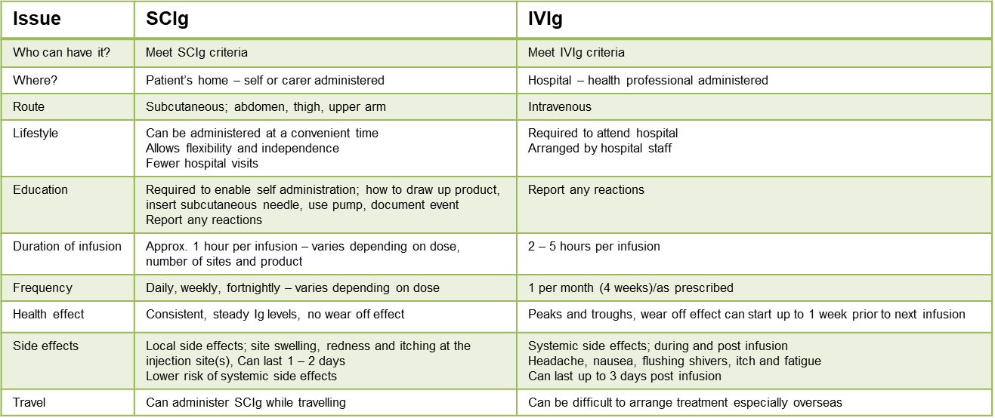
Comparison table between SCIg and IVIg
Subcutaneous Immunoglobulin (SCIg) - Australasian Society of Clinical Immunology and Allergy (ASCIA)
https://www.allergy.org.au/hp/papers/scig

Slide 7
Australasian Society of Clinical Immunology and Allergy (ASCIA) SCIg Position Statement
SCIg treatment for immunodeficiency is efficacious, well tolerated, has a favourable safety profile and should be available to all patients where clinically appropriate, with relevant education and follow up care.
Studies have demonstrated:
Immune Replacement Therapy using SCIg has equivalent efficacy to IVIg in preventing bacterial infections in patients with antibody deficiencies.
Results suggest that maintaining higher steady state IgG levels results in fewer infections.
Incidence of infection is inversely related to the steady state IgG level and maintaining higher IgG levels are beneficial, although no given level is necessarily adequate for all patients.
Studies indicate that SCIg infusions result in more stable serum immunoglobulin concentrations with little fluctuation in IgG levels compared to the peaks and troughs of IgG levels associated with monthly IVIg administration.
More stable IgG levels reduce the risk of immediate and systemic adverse effects due to high IgG levels post-infusion and symptoms related to wearing off effects of IgG trough levels.
SCIg therapy has been shown to be well tolerated with a low risk of systemic side effects.
Whilst local tissue reactions are frequent with SCIg therapy, they are often mild and tend to improve over time. Provision of adrenaline autoinjectors is not considered to be necessary, given the demonstrated safety of SCIg infusions.
Based on Recommendation 5 ASCIA Position statement - subcutaneous immunoglobulin (SCIg)
Subcutaneous Immunoglobulin (SCIg) - Australasian Society of Clinical Immunology and Allergy (ASCIA)
https://www.allergy.org.au/hp/papers/scig

Slide 8

Putting the SCIg pieces together
Patient population to support SCIg program
Submit and obtain NBA approval
Stakeholder engagement
Select and consent patients for SCIg
Health service obtains Executive approval to commence a SCIg program
BloodSTAR access
Commence SCIg program
Document development
Provide patient education
Staff identified to oversee SCIg program
Source equipment and consumables

Slide 9
Patient eligibility/criteria
Patients must meet approved clinical indication as set out in the Criteria for the use of immunoglobulin products <https://www.blood.gov.au/criteria-immunoglobulin-products>
The patient must be treated by a clinical specialist within a hospital based SCIg program, where the hospital provides access to all resources and takes full accountability for the management and use of the SCIg product, at no additional cost to patients
Patient-specific SCIg request must be submitted to, and authorised by, the Australian Red Cross Lifeblood (Lifeblood) via BloodSTAR.

Slide 10
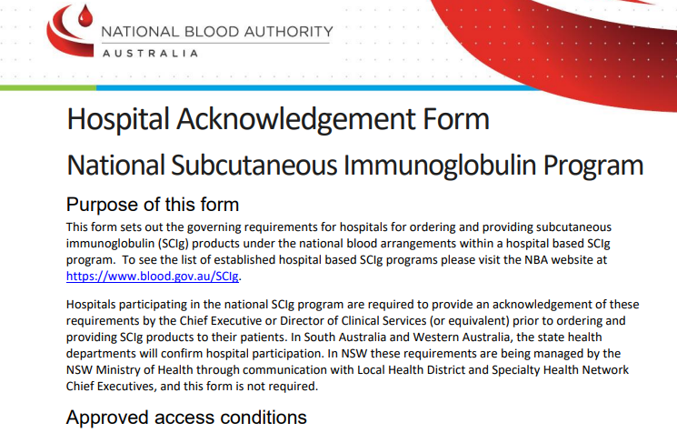
Health service eligibility criteria
The hospital must be approved by the NBA to commence a hospital based SCIg program
The NBA - Hospital Acknowledgement Form National Subcutaneous Immunoglobulin Program must be completed and includes governance requirements for the program. SCIg-hospital-acknowledgment-form-2021_2.docx < https://www.blood.gov.au/sites/default/files/documents/scig-hospital-acknowledgment-form-2021.pdf >
Completed form must be returned to the to the National Blood Authority Email: iggovernance@blood.gov.au Fax: (02) 6151 5235 (Attention: Ig Governance)

Slide 11
Governance – quality assurance & clinical oversight
Quality assurance
Policies and procedures that provide quality assurance and monitor compliance for the management and use of SCIg in line with the National Safety and Quality Health Service (NSQHS) Standards.
Who will write the policies/procedures?
Who will monitor compliance?
Clinical oversight
A recognised treatment program for the management and use of immunoglobulin for the relevant indications, including an appropriate supervising specialist
Must provide ongoing clinical oversight and support for participating patients
The responsible clinician must consider patient suitability for the self-management and administration of SCIg to ensure appropriate management and use of SCIg product.

Slide 12
Governance – equipment, facilities, education & training
Equipment and facilities
Must ensure that patients have access to all necessary equipment and consumables to administer the product, at no additional cost to patients
What equipment will be used?
Where will the patient education take place?
Where will the patient get the necessary consumables from?
Who will ensure the patient has everything they need?
Education and training
Must provide education and training for staff and patients to ensure appropriate management and use of SCIg, including transport, storage, use of equipment and infusion techniques
Who will provide the staff education?
Who will be responsible for patient education?

Slide 13
Governance – review and product supply
Regular review
Assessing clinical benefit of treatment for ongoing therapy should be conducted at periods specified by the responsible clinician in line with the Criteria
Patients should be encouraged to maintain a diary to record SCIg product use and any adverse reactions, as well as collection and management of product as an aid for the clinician at the assessment
Supply of product
Orders for SCIg for authorised patients must be managed via BloodSTAR
The amount of SCIg supplied to a patient should not exceed more than is required for treatment for two months
Supply and dispensing of SCIg product to patients must be in accordance with relevant state/territory legal requirements
SCIg is an S4 medication and must be dispensed by a pharmacist
Requires a medication prescription; must provide a copy to the pharmacy

Slide 14
Governance – reporting unused, discarded, spoilt/broken product
Reporting unused, discarded, spoilt/broken product
Patients supplied with SCIg will be expected to report details of unused, discarded or spoilt/broken product to the hospital, to be reported by the hospital through BloodNet
Who will the patient report this to?
How will the patient report this?

Slide 15
Other considerations
Cost benefit analysis – business case to support the decision (template available on Blood Matters SCIg program, tools and resources webpage) Subcutaneous immunoglobulin (SCIg) program: tools and resources | health.vic.gov.au <https://www.health.vic.gov.au/patient-care/subcutaneous-immunoglobulin-scig-program-tools-and-resources>
Clinical engagement – medical, nursing and pharmacy staff
Space – is there a suitable ward/location for patient education?
BloodSTAR and BloodNet registration and education
Prescription required by pharmacy to dispense product

Slide 16

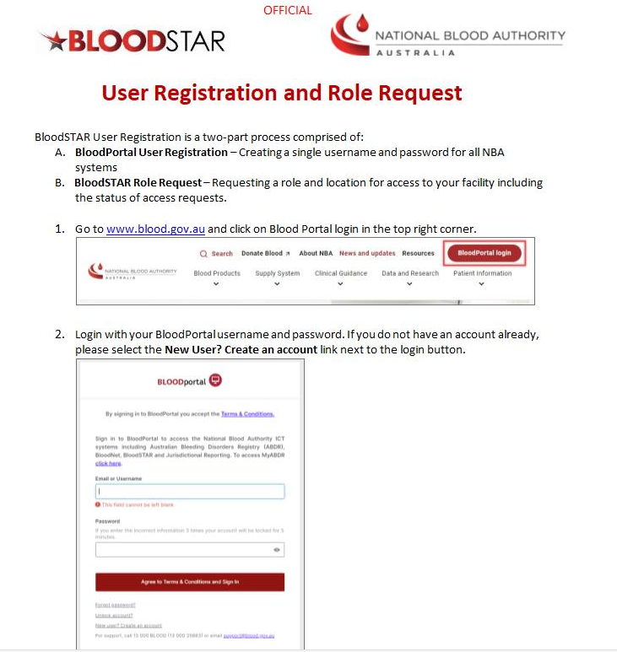
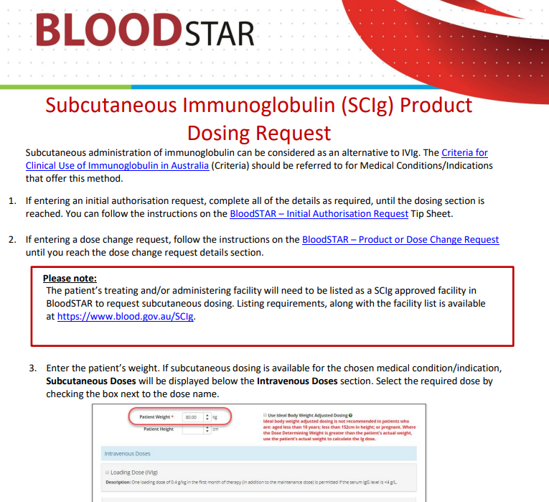
BloodSTAR
Two-part process
BloodPortal user registration
create username and password for all NBA systems
BloodSTAR role request
request a role and location for access to your facility
Home | National Blood Authority <https://www.blood.gov.au/>
BloodSTAR user tips and support materials
BloodSTAR user tips and support materials | National Blood Authority
<https://www.blood.gov.au/bloodstar-user-tips-and-support-materials>

Slide 17
Ordering SCIg flow
Patient meets SCIg criteria
MO requests SCIg authorisation via BloodSTAR
Lifeblood approval via BloodSTAR
Nurse (or delegate) completes SCIg planning sheet (BloodSTAR) or other local process
Pharmacy or blood bank order product from Lifeblood via BloodNET
Product delivered to blood bank or pharmacy by Lifeblood
Blood bank or pharmacy complete dispensing of SCIg in BloodNET
Blood bank can issue for inpatient use only
Pharmacy complete S4 dispensing for home use (MO provides prescription)

Slide 18
Products, storage, & vials
 | Hizentra® AU* | Hizentra®* | Cuvitru®* | Xembify®*
Plasma source | Local | Imported | Imported | Imported
Stabilizer | Proline | Proline | Glycine | Glycine
Concentration | 20% | 20% | 20% | 20%
Storage | <25°C (do not freeze, store in outer carton to protect from light, should be room temperature prior to administration) | <25°C (do not freeze, store in outer carton to protect from light, should be room temperature prior to administration) | 2 – 8°C (do not freeze, store in outer carton to protect from light, allow to reach room temperature prior to administration) | 2 – 8°C (do not freeze, store in outer carton to protect from light, allow to reach room temperature prior to administration) May be stored ≤25°C for up to 6 months any time prior to expiry date
Vial sizes | 1g (5mL), 4g (20mL) | 1g (5mL), 2g (10mL), 4g (20mL), 10g (50mL) | 1g (5mL), 2g (10mL), 4g (20mL), 8g (40mL) | 1g (5mL), 2g (10mL), 4g (20mL), 10g (50mL)
* Refer to Product information for further information

Slide 19
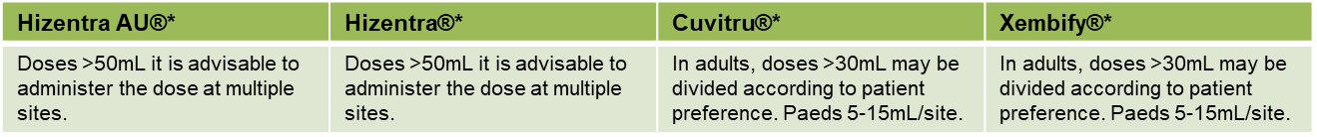
SCIg infusion sites
Administer in the subcutaneous tissue only
Abdomen - (at least 5cm from the umbilicus), thigh, upper arm, lateral hip
If using multiple sites, ensure they are at least 5cm apart
Do not insert the needle where the skin is scarred, bruised, broken or inflamed
Same sites V’s rotating sites
* Refer to Product information for further information

Slide 20
Equipment: pumps & consumables
Cooler bag/esky for transport (ice brick)
Infusion pump
Subcutaneous infusion set
Sharps container
Antibacterial wipes or soapy water (to clean a work surface or infusion mat)
Alcohol swabs
Luer lock syringe(s)
Drawing up needle(s)/vented dispensing pin
Adhesive dressing
Small band aid/gauze/cotton ball
Infusion diary/Infusion App

Slide 21
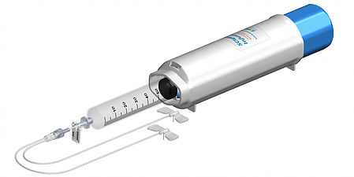
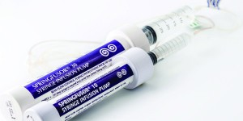
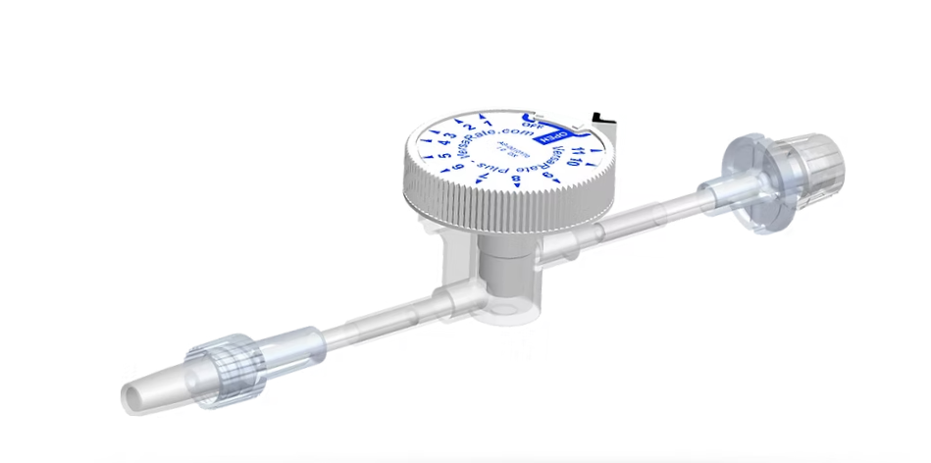
Pumps
Springfuser ® syringe infusion pump - 10,30 or 50
Go Medical Industries Pty Ltd - Springfusor & FCT <https://www.gomedical.com.au/products/infusion/springfusor-fct>
Spring driven
10ml, 30ml or 50ml Syringe (syringe size varies with pump size)
Flow rate control tubing and syringe (purchased separately)
Can be used with any needle system
Emed - SCIg 60 infusion system
Explore Our Infusion Products | EMED Technologies
<https://www.emedtc.com/explore-our-infusion-products>
Spring driven
50/60mL BD syringe
Rate controller

Slide 22
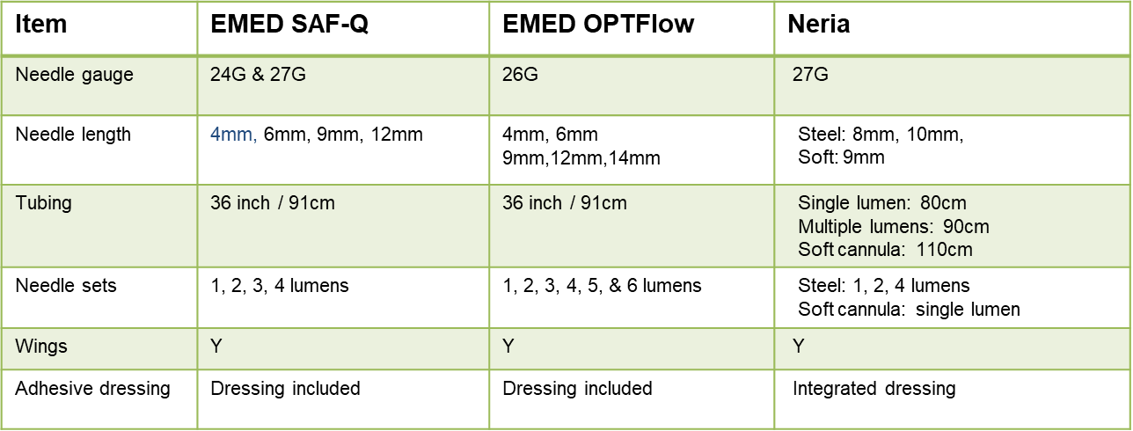
Subcutaneous infusion sets

Slide 23
Patient selection
Meet SCIg criteria
Willingness to self-infuse or for carer to infuse
Patient or carer with the dexterity and ability to administer SCIg
Ability to store product at required temperature
Patients with difficult IV access
Patients who have significant or frequent reactions to IVIg
Patients who travel a long way to get treatment
Patients who are time poor for any reason and find it difficult to attend for IVIg
Patients who may be more compliant with SCIg than IVIg – assess reason for non-compliance
Patients who do not have severe thrombocytopenia

Slide 24
Contraindications to SCIg*
Anaphylactic or severe systemic reactions to immunoglobulin (Ig)
Extensive skin conditions- psoriasis, eczema
Cognitive impairment
Poor manual dexterity, decreased hand grip, tremors, poor eyesight
IgA deficiency – discuss with immunologist
Severe thrombocytopenia
Hizentra® AU - patients with known hyperprolinemia (type I or II)
Hizentra® - patients with known hyperprolinemia (type I or II)
Cuvitru® - patients with known reactions to glycine and patients with IgA deficiency
Xembify® - patients with known reactions to glycine and patients with IgA deficiency
* Refer to product information

Slide 25
Patient education
Clean work area
Hand washing & aseptic technique
Pump & consumables
Injection site selection & care
Checking of product
Drawing up product
Priming infusion set – dry prime
Skin preparation & needle insertion technique
Needle placement check
Infusion rate, commencement & completion
Documentation – diary/App
Adverse reaction management
Ordering & collection of product & consumables
Transport & storage of product
Reporting waste
Manual push method (pump failure)

Slide 26
Documentation
Record in the patient infusion diary/infusion App/medical record:
Product name
Batch number & expiry date
Dose
Volume
Infusion commencement time
Infusion completion time
Infusion site(s)
Symptoms/side effects

Slide 27
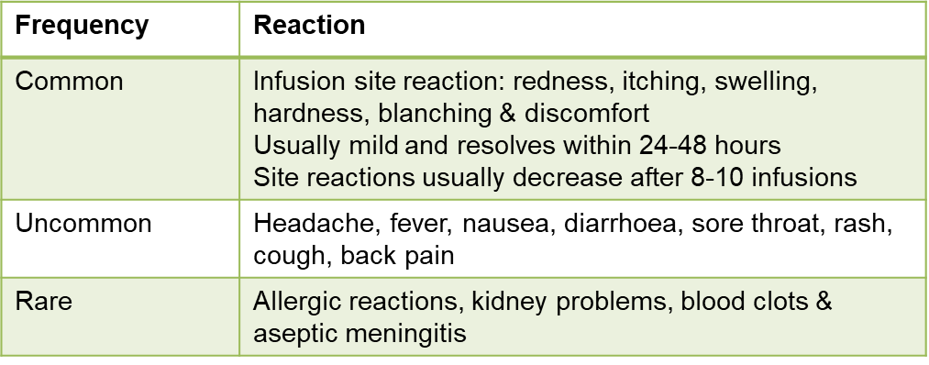
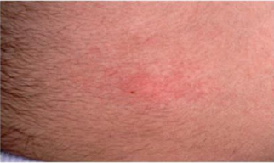
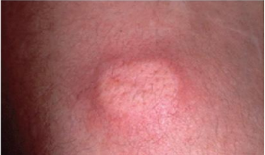
Adverse reactions*
Subcutaneous immunoglobulin (SCIg) therapy - general information - Australasian Society of Clinical Immunology and Allergy (ASCIA)
<https://www.allergy.org.au/patients/immunodeficiencies/scig-therapy-general-information?highlight=WyJzY2lnIiwiZmFxIl0=>
Report adverse reactions to relevant product manufacturer or TGA
*Refer to product information for specific adverse reaction information

Slide 28
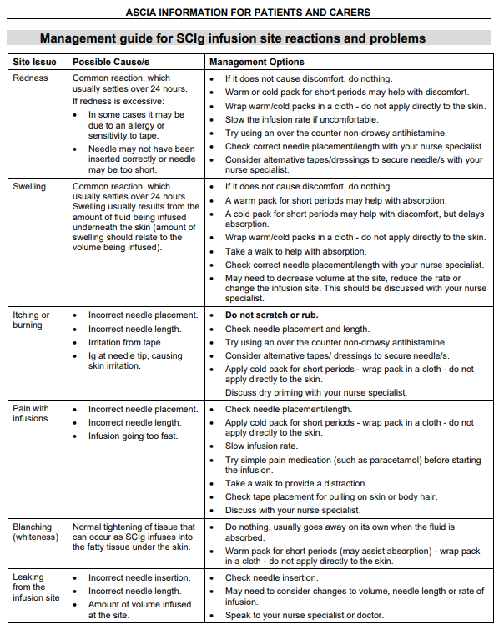
Management of infusion site reactions
If an infusion site reaction occurs:
Apply gentle massage and warm or cold pack (according to personal preference) to reduce discomfort. An ice pack should not be applied for four hours post infusion to ensure adequate absorption.
Do not rub or scratch the infusion site.
Record site reactions in an infusion diary.
Subcutaneous immunoglobulin (SCIg) therapy - general information - Australasian Society of Clinical Immunology and Allergy (ASCIA)
<https://www.allergy.org.au/patients/immunodeficiencies/scig-therapy-general-information?highlight=WyJzY2lnIiwiZmFxIl0=>

Slide 29
Patient support programs
Each SCIg product manufacturer has a patient support program
CSL Behring Cares
Takeda Cuvitru at Home
Grifols Xembify Connex
Accessed via a referral form
Provide SCIg administration education in the patient’s home, supply some consumables
Suite of SCIg resources for patients and health care professionals

Slide 30
Questions to you
What support/assistance do you need?
Business case
Policy/procedure
Staff education and checklist
Patient education and checklist

Slide 31
Further information:
Contact: Anne Graham
Blood Matters Nurse Consultant (SCIg)
Phone: 03 9694 0126
Blood Matters Subcutaneous immunoglobulin (SCIg) access & information, tools and resources:
https://www.health.vic.gov.au/patient-care/subcutaneous-immunoglobulin-scig-access-program <https://www.health.vic.gov.au/patient-care/subcutaneous-immunoglobulin-scig-access-program>

Slide 32
Acknowledgement
Australian governments fund the Australian Red Cross Lifeblood to provide blood, blood products and services to the Australian community.

Slide 33
Accessibility
To receive this presentation in another format phone 03 9694 0102, using the National Relay Service 13 36 77 if required, or email Blood Matters <bloodmatters@redcrossblood.org.au>.
Authorised and published by the Victorian Government, 1 Treasury Place, Melbourne.
© State of Victoria, Australia, Department of Health, January 2026.
ISBN 978-1-76131-192-5 (pdf/online/MS word)
Available at Blood Matters Program <https://www.health.vic.gov.au/patient-care/blood-matters-program>

Slide 34

Acknowledgement/s
Australian governments fund the Australian Red Cross Lifeblood for the provision of blood, blood products and services to the Australian community.
Notes:
Australian governments fund the Australian Red Cross Lifeblood for the provision of blood, blood products and services to the Australian community.

