Slide 1
Treating and controlling head lice
Presentation for parents and carers
OFFICIAL

Slide 2
Myths about head lice
  Kids with lice always scratch or itch.
    50% don’t scratch or itch when they have head lice.
  Head lice jump or fly from head to head.
    Head lice cannot fly or jump.
  Head lice live in carpets, beds and clothes.
    Head lice only live on human heads.
  You only need to treat head lice once.
    One treatment is not enough. When and how many times you need to do a treatment will depend on the method used.

Slide 3
Myths about head lice (cont’)
  Everyone in the family will need to be treated.
    You only need to treat those family members with live lice.
  There are products available that prevent you catching head lice.
    There are no products available that will prevent the transmission of head lice. It is best to tie long hair back and check for lice regularly.
  Head lice are selective about what type of hair they live in
    Head lice like all types of hair – clean, dirty, long, short, blonde, brown…

Slide 4
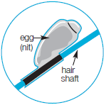
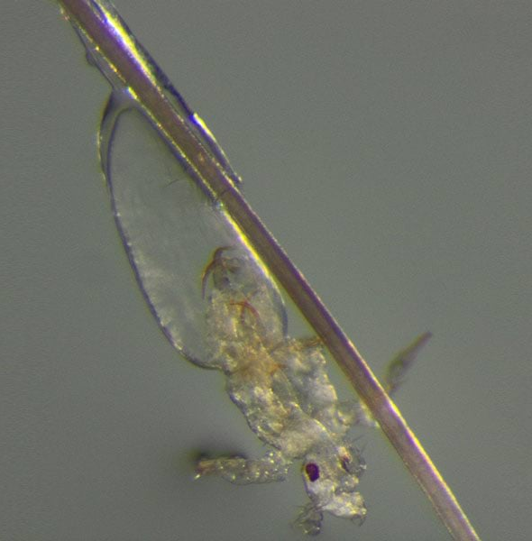
The life cycle of head lice
    Eggs (also called nits) are laid close to the scalp
    They hatch after 6 to 7 days incubation
    There a 3 nymph (baby) stages before they mature into an adult which happens 10 days after hatching
    Lice live for about 30 days
    Females lay 3 to 8 eggs per day
Louse hatching
Better Health Channel

Slide 5
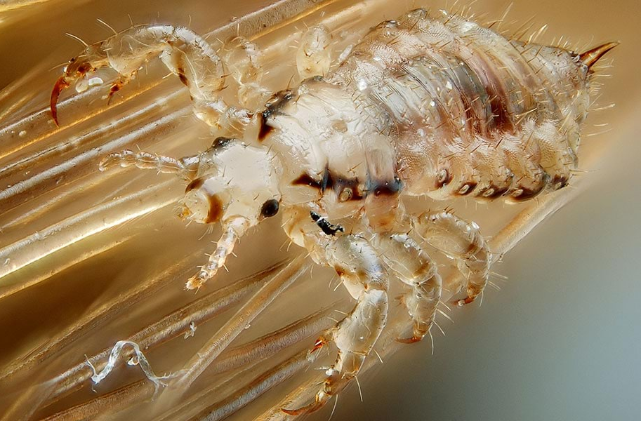
Some facts about head lice
    Head lice spend their entire life on the human head
    Few lice ever fall off the head
    Those that do are probably about to die
    If healthy lice fall, they generally die quickly depending on how humid it is because:
      they require blood to survive (they feed three to four times a day)
      without blood they will dehydrate in a dry climate in about six hours and 24 hours in a humid climate
Better Health Channel

Slide 6
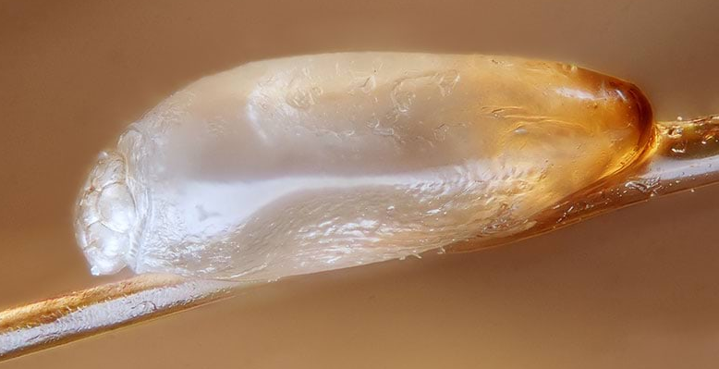
How to identify head lice eggs (nits)
    It is helpful to be able to identify the eggs of head lice
    Sunlight or strong light and magnification may help (see the next slide for pictures of eggs)
    If a child has empty hatched eggs or dead eggs and no live lice or crawlers they do not have an active infection and no treatment is needed
Better Health Channel

Slide 7
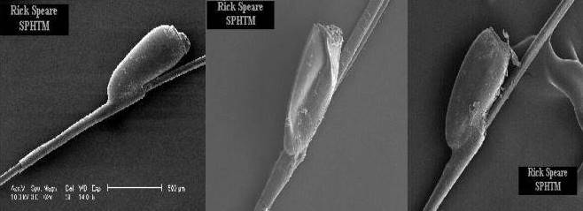
Identifying head lice eggs
Lice eggs have curved walls and will pop when squeezed
Dead eggs have collapsed sides
Hatched eggs have a flat top in profile
Photos: Professor Rick Speare

Slide 8
Steps for detecting and treating head lice (1/3)
Step 1: Detection
    Comb hair conditioner onto dry, brushed hair
    Divide hair into small (3-4cm) sections
    Comb through sections 3-4 times (use a fine-toothed louse comb)
    Wipe comb onto paper towel
    Look for lice or eggs
Step 2: Treatment
    Use a licensed or registered head lice treatment product (ask your pharmacist)
  OR
    Use the comb and conditioner method every 2 days until no lice are found for 10 days

Slide 9
Steps for detecting and treating head lice (2/3)
Step 3: Check for resistance
    If you used an insecticide, the lice should be dead in 20 minutes
    Check after this time to see if the head lice are still moving
      No => the product has worked
      Yes => the product has not worked
    If the insecticide hasn’t worked, re-treat using a different product with a different active ingredient or use the comb and conditioner method

Slide 10
Steps for detecting and treating head lice (3/3)
Step 4: Retreatment
    Reapply the product 7 days after the first treatment
    For heavy infestations, retreat 7 days after the second treatment
    Do not apply the treatment more than once per week as more frequent applications could lead to scalp problems and have little or no effect

Slide 11
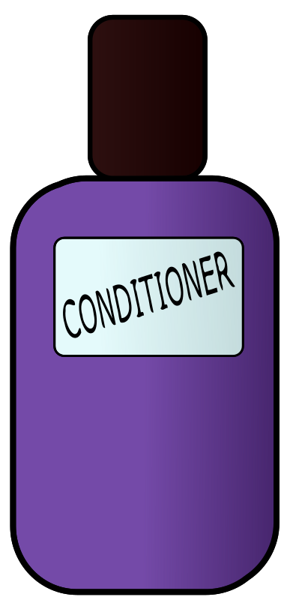
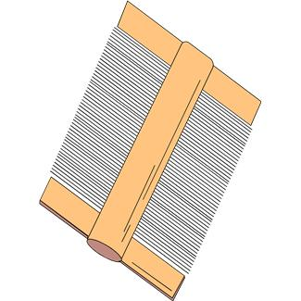
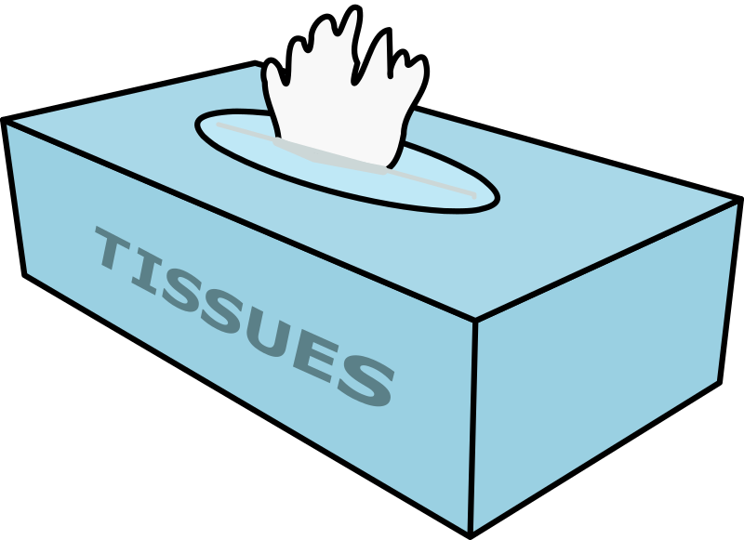
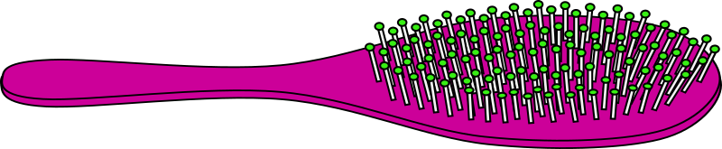
What if the lice aren’t dead?
    Lice resistance to products cannot be predicted
    Re-treat as soon as possible using a product with a different active chemical
    Discuss with your pharmacist which products are best to use and which have different active ingredients/chemicals

Slide 12
Nothing is working!
  The four reasons for treatment failure are:
    Incorrect application (e.g., how long the product was left in or not all hair was in contact with the product)
    Lice are resistant to the chemical
    Failure to re-treat
    Reinfestation
  If you are having trouble start at the top of the list and work down.

Slide 13
Remember these points
    Always check for lice before treating
    No treatment kills 100% of the eggs
    Re-treat 7 days after the first application (or as required for the comb/conditioner method)
    Test to make sure the treatment has worked and change products if necessary
    Nits are the most difficult to kill. The most effective way to remove eggs is to pull them off the hair using your fingernails
    Head lice can be controlled but it takes a systematic approach

Slide 14
Need more information?
Victorian Department of Health
  https://www.health.vic.gov.au/infectious-diseases/head-lice
Better Health Channel
  https://www.betterhealth.vic.gov.au/health/conditionsandtreatments/head-lice-nits
Victorian Department of education
  https://www2.education.vic.gov.au/pal/head-lice/policy

Slide 15
Accessibility statement and publisher information
  To receive this presentation in another format phone 1300 651 160, using the National Relay Service 13 36 77 if required, or email the Communicable Disease Section, <infectious.diseases@health.vic.gov.au>.
  Authorised and published by the Victorian Government, 1 Treasury Place, Melbourne.
  © State of Victoria, Australia, Department of Health, May 2024.
  Available on the department’s Head lice webpage <https://www.health.vic.gov.au/infectious-diseases/head-lice>

