Slide 1
Head lice
Are you scratching for answers?
OFFICIAL

Slide 2
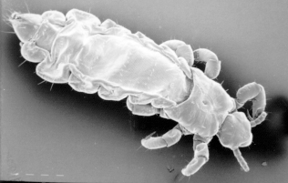
What do we know about head lice? (1/6)
What are head lice?
    Head lice are tiny wingless insects that lay eggs
    This is a close-up picture of one
Photo: Professor Rick Speare

Slide 3
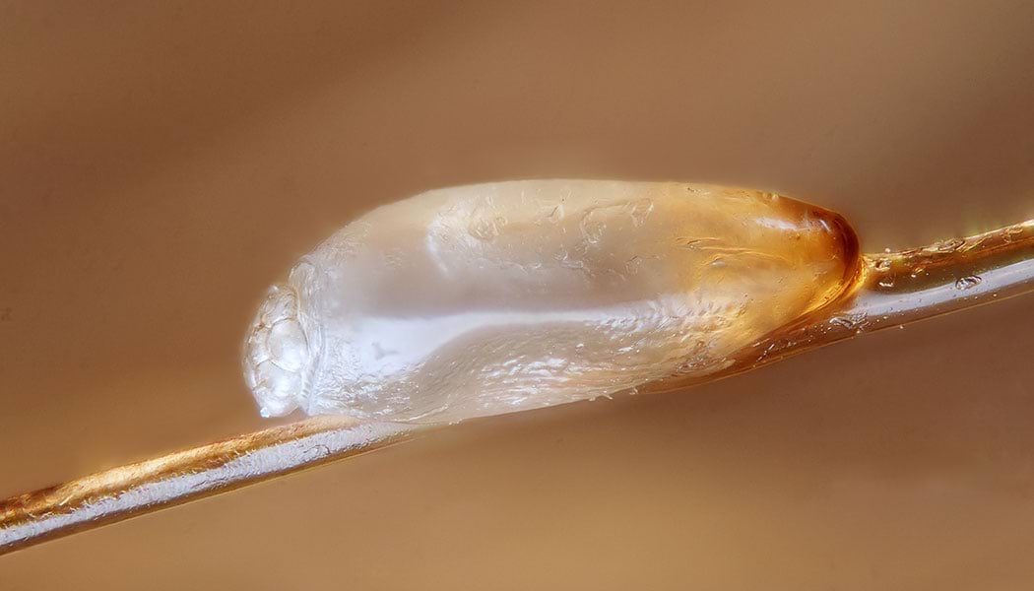
What do we know about head lice? (2/6)
What is a nit?
    A nit is a head lice egg
    They hatch 7 days after being laid
    This is a photo of one up close before it has hatched
Better Health Channel

Slide 4
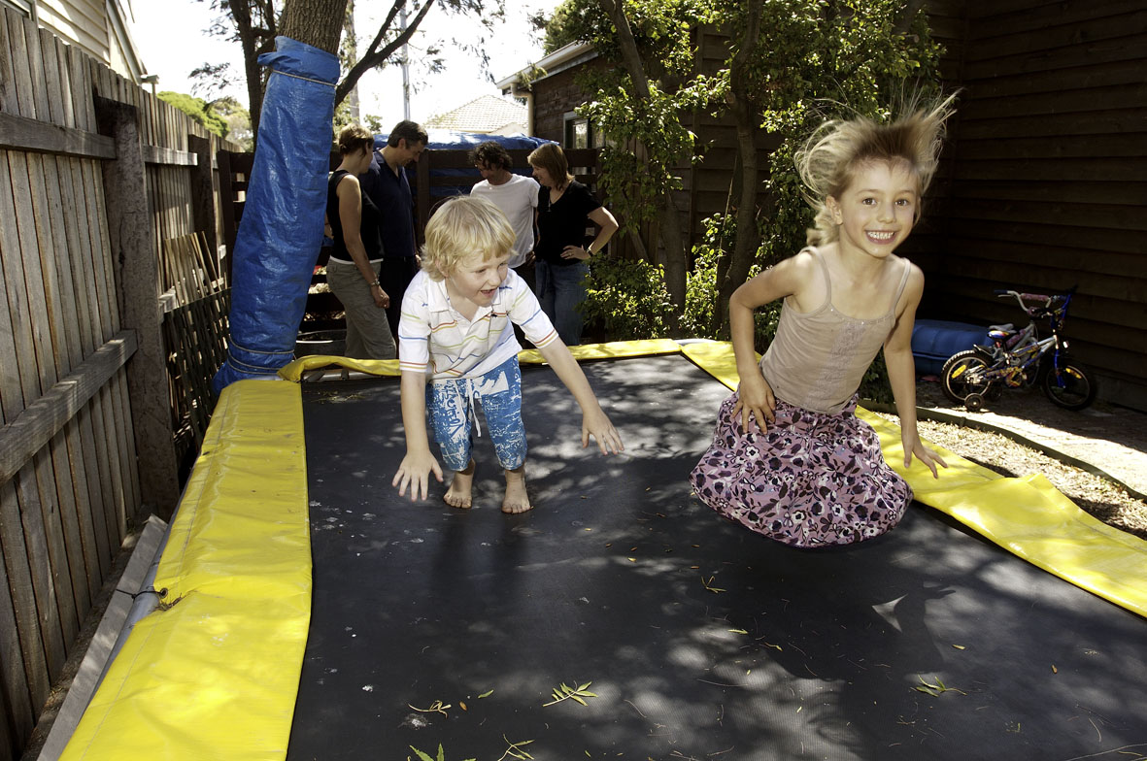
What do we know about head lice? (3/6)
Who gets head lice?
    Only people do!
Where do head lice live?
    Head lice only live on our heads

Slide 5
What do we know about head lice? (5/6)
How do we get head lice?
    Head lice crawl from one head to another when we have our heads very close to another person
    This could be:
      Your friends
      Your classmates
      Your brothers or sisters

Slide 6
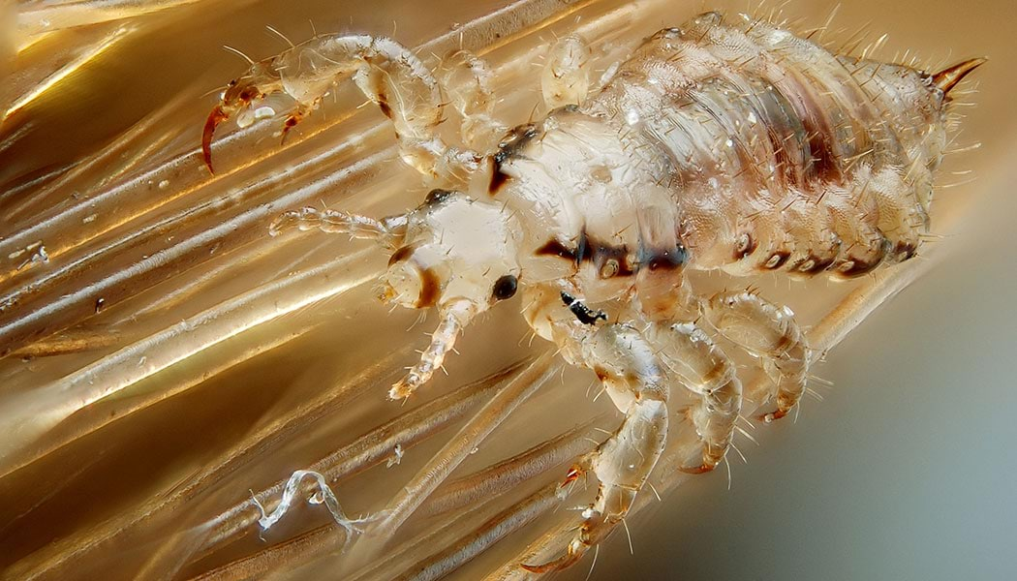
What do we know about head lice? (6/6)
What do head lice do?
    Head lice feed on our blood
    They cling to hair and swing from hair to hair like acrobats
    They lay their eggs on a strand of hair close to the head
    Here is a picture of the claw of a head louse
Better Health Channel

Slide 7
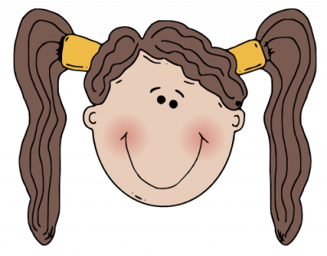
How can we avoid getting head lice?
    If you have long hair, tie it up during the day
    Ask your parent or carer to help you check your hair every week for head lice using conditioner and a head lice comb

Slide 8
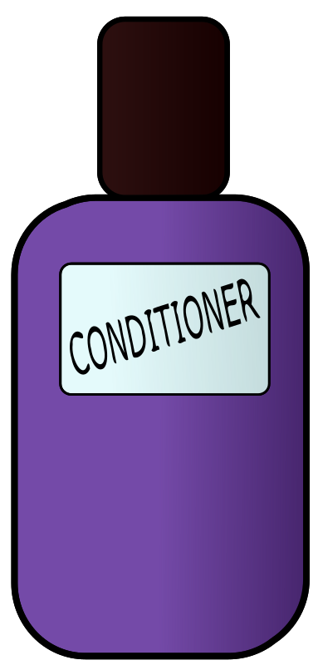
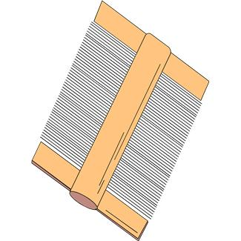

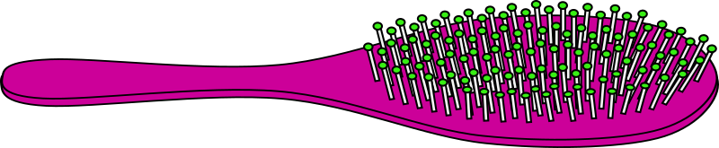
How do I look for head lice?
You will need:
    White conditioner
    A normal comb or brush
    A head lice comb
    Tissues or paper towel
    Help from a grown up
How to do it:
    Comb the conditioner onto dry brushed hair
    Use the head lice comb to comb sections of your hair
    Wipe the conditioner onto a tissue
    Look for lice and eggs

Slide 9
Some common myths about head lice (1/3)
  Head lice can make you very sick
  False!
  Head lice are harmless and do not spread disease

Slide 10
Some common myths about head lice (2/3)
  All children scratch when they have head lice
  False!
  Less than half of people who have head lice scratch

Slide 11
Some common myths about head lice (3/3)
  Head lice can fly and jump from one head to another
  False!
  Head lice can’t jump (they don’t have knees) but do crawl very fast. They spread by crawling head to head.

Slide 12
What should I do if I have head lice?
    You can get rid of them by using a head lice comb and conditioner every 2nd day until you haven’t found any head lice for 10 days or by using a head lice treatment (retreat after 7 days)
    Have everyone in your family check their hair too

Slide 13
Need more information?
Have a look at these great websites
  Better Health Channel
    https://www.betterhealth.vic.gov.au/health/conditionsandtreatments/head-lice-nits
  Victorian Department of Health
    https://www.health.vic.gov.au/infectious-diseases/head-lice

Slide 14
Accessibility statement and publisher information
  To receive this presentation in another format phone 1300 651 160, using the National Relay Service 13 36 77 if required, or email the Communicable Disease Section, <infectious.diseases@health.vic.gov.au>.
  Authorised and published by the Victorian Government, 1 Treasury Place, Melbourne.
  © State of Victoria, Australia, Department of Health, May 2024.
  Available at on the department’s Head lice webpage <https://www.health.vic.gov.au/infectious-diseases/head-lice>

