Slide 1
Intravenous immunoglobulin
Blood Matters and the Victorian Transfusion Nurses (Australian Red Cross Lifeblood)
July 2023

Slide 2
Acknowledgment of Country
Notes:
Lifeblood and Blood Matters acknowledge and pay respect to the past, present and future traditional custodians and elders of this land and the continuation of cultural, spiritual and educational practices of Aboriginal and Torres Strait Islander peoples.

Slide 3
Disclaimer
This presentation is intended to assist with education of clinical staff who provide treatment and care for patients receiving intravenous immunoglobulin therapy.
Information in this presentation is accurate at time of publication.

Slide 4
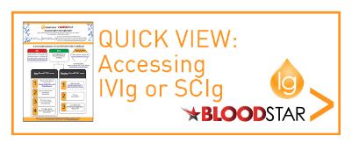
Background
Immunoglobulin products provide critical therapy, and can be a life-saving treatment, for people with immunodeficiencies and some autoimmune disorders.
The NBA actively manages the national supply and allocation of immunoglobulin in conjunction with the Australian Red Cross Lifeblood (Lifeblood).
Increase in demand for IVIg has declined since IVIg governance program was initiated but remains at 7.3% PA. (https://www.blood.gov.au/Ig-program-updates )
Notes:
Management includes:
Criteria for use of IVIg in Australia, that defines the diseases and conditions where evidence supports the use of IVIg for treatment
BloodStar, an online system used across Australia to manage access to the supply of government funded immunoglobulin products. The system manages the authorisation request and review process for the treatment of conditions identified in the Criteria for the clinical use of intravenous immunoglobulin in Australia
Importing product to fill shortfall in the Australian supply

Slide 5
Current supply arrangements
Domestic IVIg product | Privigen® AU 10% (to replace Intragam® 10) available April 2023 | CSL Behring
Imported IVIg products | Flebogamma® 5% & 10% | Grifols Australia
 | Gamunex® 10% | Grifols Australia
 | Privigen® 10% | CSL Behring
 | Octagam® 10% | Octapharma
 | Kiovig 10% from May 2023 | Takeda
Domestic SCIg product | Evogam® | CSL Behring
Imported SCIg products | Hizentra® 20% | CSL Behring
 | Cuvitru® 20% | Takeda
NBA national product price list July 2022
Notes:
Under the National Fractionation Agreement for Australia between the National Blood Authority and CSL Behring, CSL Behring has been investing in new facilities at its manufacturing site at Broadmeadows in Victoria to provide expanded capacity for processing Australia’s growing annual domestic plasma collections.
Under this transition the manufacturing process for five of Australia’s domestic plasma products will change. The products will continue to be manufactured in Australia from Australia’s plasma, but will be manufactured using CSL Behring’s global manufacturing processes.
The trade names of the transitioned products reflect their manufacturing process, while the AU denotes the product is manufactured from plasma collected in Australia.
In 2023 these changes will commence.
When this occurs Intragam 10 will become Privigen AU, both products being a 10% formulation.
For SCIg Evagam will be replace with Hizentra AU which will be a 20% formulation compared to 16% for Evogam.

Slide 6
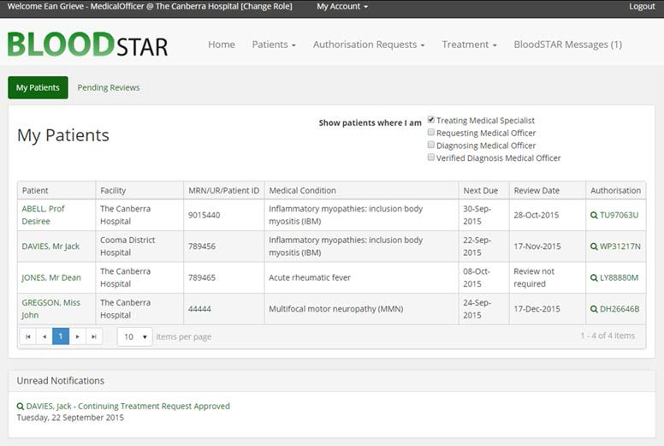
BloodSTAR
Who uses BloodSTAR?
Prescribers – request authorisation for access to government funded Ig for patient treatment
Authorisers – specified staff of the Australian Red Cross Lifeblood; authorise initial and continuing access
Nurses – coordinate patient treatments
Dispensers – manage inventory, order products and dispense the correct products to authorised patients
Notes:
Prescribers – In the course of managing patient treatment, at the point of requesting authorisation for access to government funded product for the treatment of a patient’s medical condition
Authorisers – Specified staff of the Australian Red Cross (link is external)Lifeblood(link is external) are responsible for authorising initial and continuing access to government funded immunoglobulin products;
Nurses – In the course of managing patient treatment, to confirm patient’s authorisation status, request the dispense of product and coordinate with patient’s infusion appointments to ensure the correct product is dispensed; and
Dispensers – In the course of managing inventory, ordering and dispensing the correct product to authorised patients.​
Admin Support - This role has been designed for Enrolled Nurses and Administrative Support staff to assist Medical Officers and Nurses/Midwifes to manage patients’ treatment. The admin support role has the same functionality as a Nurse/Midwife role without the ability to update patient consent, edit the ‘Do Not Prescribe’ register, and edit authorisations (transfer of care or change the treating medical specialist). This role does not require AHPRA registration.

Slide 7
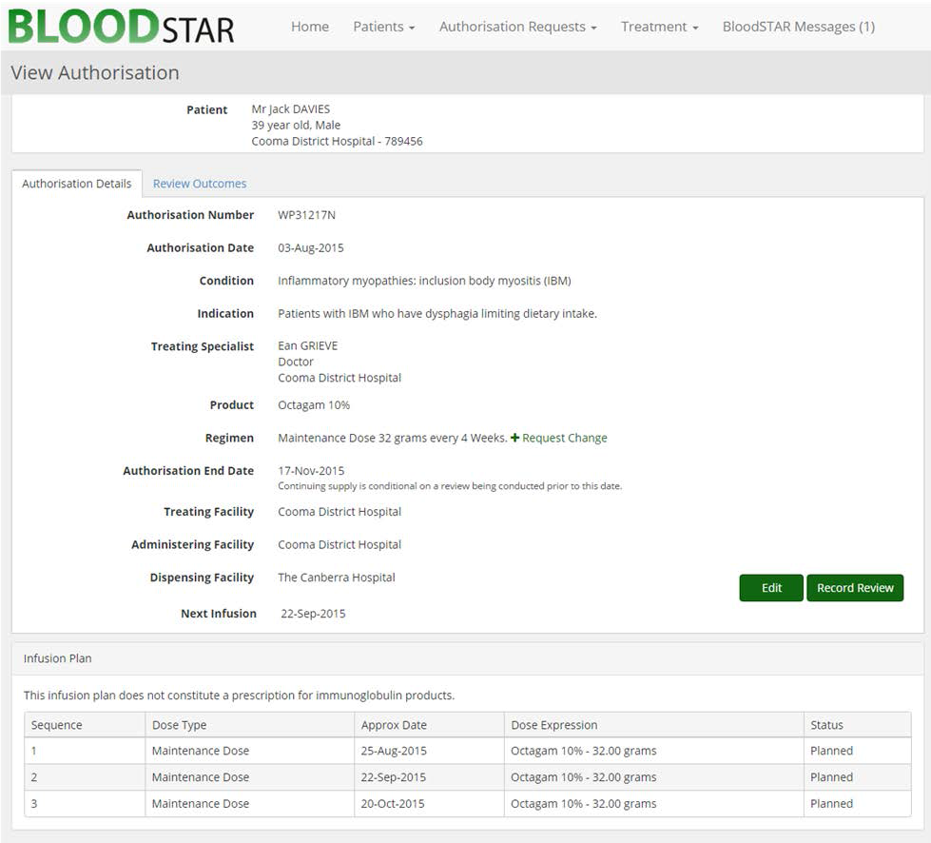
BloodSTAR – view authorisation
View authorisation provides a central point for checking a patients authorised dose and status.
In BloodSTAR:
Prescribers and nurses can view this for all patients at their facility.
Medical Officers can also record review outcomes for the patients from this screen.
In BloodNET:
Dispensers can view the same level of detail using the Check Authorisation function
BloodSTAR-Tip-Sheet-Viewing-authorisation-details-in-BloodSTAR.pdf
The prescriber should be contacted for questions about dose or product

Slide 8
The Criteria for Immunoglobulin Use in Australia
The Criteria for Immunoglobulin Use in Australia (the Criteria) Version 3, released in October 2018
Why did the Criteria change?
To align with new evidence
To ensure Ig therapy is available for appropriate patient use
To manage the growth in demand for this precious, human-derived product
For more information on the Criteria and the Immunoglobulin Governance program visit https://www.blood.gov.au/Ig-governance
For the latest Immunoglobulin Governance updates visit https://www.blood.gov.au/Ig-program-updates

Slide 9



BloodSTAR – further information
Further information on BloodSTAR and its’ use you can find at the National Blood Authority website:L https://www.blood.gov.au/bloodstar-support-materials
Call: 13 000 BLOOD

Slide 10
Jurisdictional direct orders (JDOs)
Doctors may want to prescribe IVIg for medical conditions not funded under the Criteria
In this case, the doctor can seek funding for IVIg through local arrangements (e.g. local health service therapeutics committee (usually via pharmacy)
Only imported IVIg is available for purchase under the JDO arrangements for indications that are not listed in the criteria
Imported IVIg can be accessed directly from the supplier at the same price negotiated by the NBA and must be paid for in full by the Approved Recipient (health service or individual patient)
https://www.blood.gov.au/Intravenous-Ig

Slide 11
Intragam ® 10 and Privigen ® AU comparison
Registered indications and dosing – The indication and dosing for PRIVIGEN® AU and INTRGAM ® 10 are different. Please refer to the approved product information for more information
Do not freeze. Protect from light
See infusion rate tables for comparison of infusion rates
Comparison information is based on the CSL Behring Privigen AU Compendium (refer to: Access to new Materials and information: https://hcp.cslbehring.com.au/ )
Characteristics | Intragam ® 10 (Discontinued) | Privigen ® AU
Source plasma | Australian voluntary non-remunerated donors | Australian voluntary non-remunerated donors
Concentration | 10% normal immunoglobulin (human) | 10% normal immunoglobulin (human)
Presentation | 25mL (2.5g), 100mL (10g), 200mL (20g) | 50mL (5g), 100mL (10g), 200mL (20g)
Excipient | Glycine | L-proline
Shelf life | 2 years | 3 years
Storage conditions | Store at 2ºC-8ºC. Once removed from refrigeration store below 25ºC and use within 3 months. | Store below 25ºC. Do not shake
Notes:
Intragam 10 will no longer be manufactured and will be replaced by Privigen AU, starting in April 2023.
All, currently on Intragam 10 will need to be moved to Privigen AU, or if there is a reason not to move to Privigen AU another IVIg.
Privigen AU will be the only Australian plasma product available, made in Australia from the plasma of Australian donors.

Slide 12
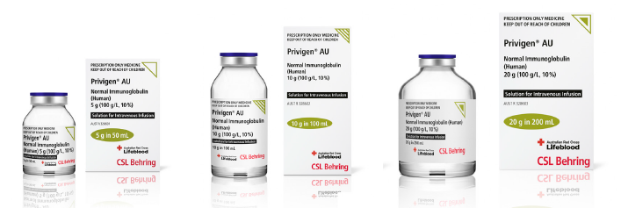
Description - Privigen® AU
Description | Privigen® AU
Presentation | 5g (50mL); 10g (100mL); 20g (200mL)
Concentration | 10%
Source plasma | Australia
Stabiliser | L-proline
Storage conditions | Store below 25°C (Do not freeze) Protect from light
Infusion rate | Start at 0.3mL/kg/hr If well tolerated, the rate can gradually increased at 30 minute intervals to maximum rate Max infusion rate of 4.8mL/kg/hr
Notes:
The starting rate is for patients new to IVIg, are switched form an alternative IVIg product, have not received an IVIg product for a long time.
In patients at risk of acute renal failure or thromboembolic adverse reactions, IVIg products should be administered at the minimum rate of infusion and dose practicable.

Slide 13
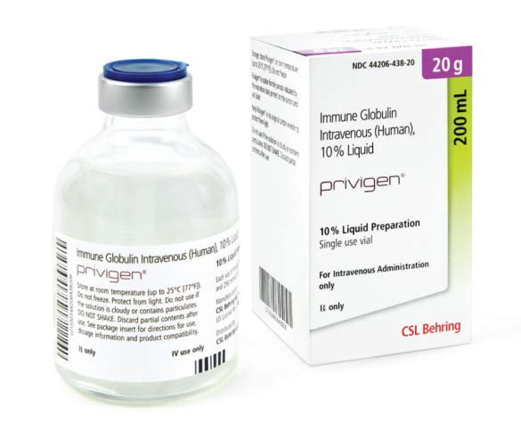
Description - Privigen® (imported)
Description | Privigen® AU
Presentation | 5g (50mL); 10g (100mL); 20g (200mL)
Concentration | 10%
Source plasma | European and USA remunerated and non-remunerated donors
Stabiliser | L-proline
Storage conditions | Store below 25°C (Do not freeze) Protect from light
Infusion rate | Start at 0.3mL/kg/hr If well tolerated, the rate can gradually be increased at 30 minute intervals to maximum rate Max infusion rate of 4.8mL/kg/hr
Notes:
The starting rate is for patients new to IVIg, are switched form an alternative IVIg product, have not received an IVIg product for a long time.
In patients at risk of acute renal failure or thromboembolic adverse reactions, IVIg products should be administered at the minimum rate of infusion and dose practicable.

Slide 14
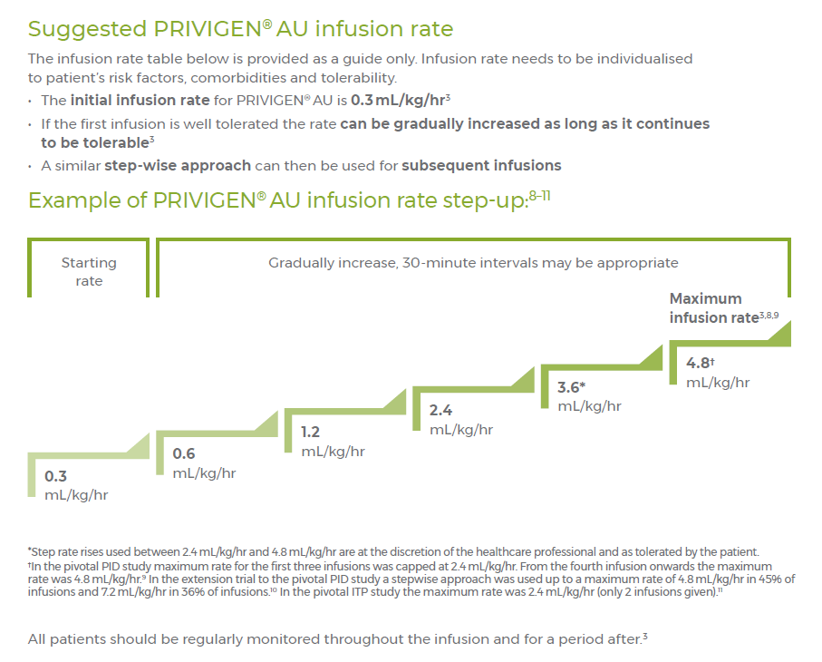
Infusion rate guide
Privigen® AU infusion rate guide (adults)
Ref: CSL Behring
Privigen AU Compendium

Slide 15
Privigen® AU (10%) and Privigen® (10%) infusion rate guide
Infusion rate mL/kg/ hr | Pump rate | 10 kg | 15 kg | 20 kg | 25 kg | 30 kg | 35 kg | 40 kg | 45 kg | 50 kg | 55 kg | 60 kg | 65 kg | 70 kg | 75 kg | 80 kg | 85 kg | 90 kg | 95 kg | 100 kg
0.3 | mL/hr | 3 | 4.5 | 6 | 7.5 | 9 | 10.5 | 12 | 13.5 | 15 | 16.5 | 18 | 19.5 | 21 | 22.5 | 24 | 25.5 | 27 | 28.5 | 30
0.6 | mL/hr | 6 | 9 | 12 | 15 | 18 | 21 | 24 | 27 | 30 | 33 | 36 | 39 | 42 | 45 | 48 | 51 | 54 | 57 | 60
1.2 | mL/hr | 12 | 18 | 24 | 30 | 36 | 42 | 48 | 54 | 60 | 66 | 72 | 78 | 84 | 90 | 96 | 102 | 108 | 114 | 120
2.4* | mL/hr | 24 | 36 | 48 | 60 | 72 | 84 | 96 | 108 | 120 | 132 | 144 | 156 | 168 | 180 | 192 | 204 | 216 | 228 | 240
3.6* | mL/hr | 36 | 54 | 72 | 90 | 108 | 126 | 144 | 162 | 180 | 198 | 216 | 234 | 252 | 270 | 288 | 306 | 324 | 342 | 360
4.8* | mL/hr | 48 | 72 | 96 | 120 | 144 | 168 | 192 | 216 | 240 | 264 | 288 | 312 | 336 | 360 | 384 | 408 | 432 | 456 | 480
*Step-up rate rises used between 2.4mL/kg/hr are at the discretion of the health care professional and as tolerated by the patient.
See the product information for more detail regarding infusion rate studies for specific patient groups.

Slide 16
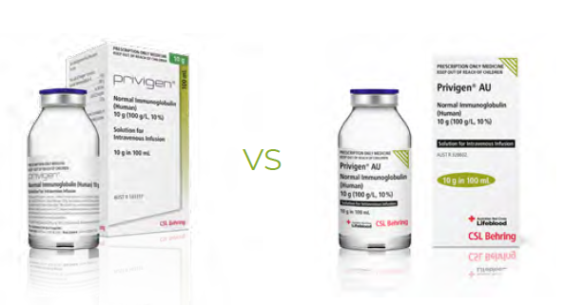
Prescribing and ordering
Clinicians must take care to prescribe and order through BloodSTAR the product they need for their patient.
Privigen ≠ Privigen AU
Notes:
Orders for administration should clearly document whether it is Privigen (imported product) or Privigen AU (Australian product) that is required for the patient.

Slide 17
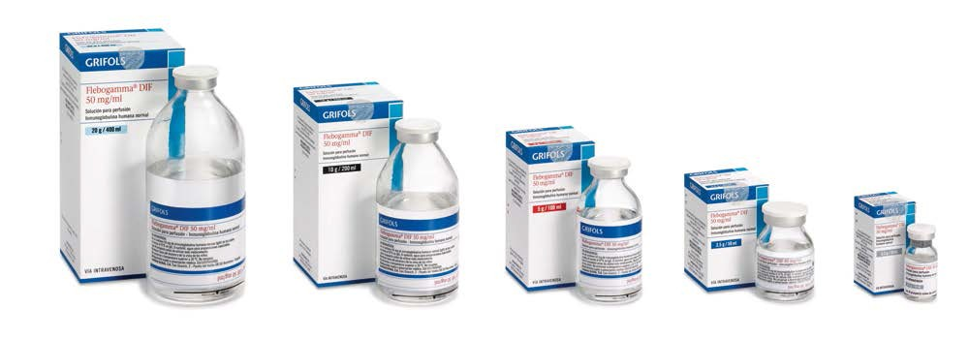
Flebogamma® 5% DIF
Description | Flebogamma® 5% DIF
Presentation | 2.5g (50mL), 5g (100mL), 10g (200mL), 20g (400mL) vials
Concentration | 5% Pay careful attention that you have the correct product strength
Source plasma | USA and European remunerated and non-remunerated donors
Stabiliser | Sorbitol
Storage conditions | Store below 30°C for up to 2 years Protect from light. Do not freeze
Infusion rate | First 30 minutes: 0.01 – 0.02 mL/kg/minute If well tolerated gradually increase rate to a maximum of 0.1 mL/kg/minute Maximum rate 0.1 mL/kg/min (6mL/kg/hour)
Note: B. Flebogamma 5% and 10% is contraindicated in babies and young children as hereditary fructose intolerance may not yet be diagnosed and may lead to a fatal reaction associated with the sorbitol stabiliser.
Image: http://www.igliving.com/magazine/ads/IGL_2010-10_AD_Grifols_Flebogamma-5-percent-DIF.pdf

Slide 18
Flebogamma® 5% DIF infusion rate guide
Infusion rate mL/kg/min | Infusion rate mL/kg/hr | Pump rate | 10 kg | 20 kg | 30 kg | 40 kg | 50 kg | 60 kg | 70 kg | 80 kg | 90 kg | 100 kg | 110 kg | 120 kg
0.01 | 0.6 | mL/hr | 6 | 12 | 18 | 24 | 30 | 36 | 42 | 48 | 54 | 60 | 66 | 72
0.02 | 1.2 | mL/hr | 12 | 24 | 36 | 48 | 60 | 72 | 84 | 96 | 108 | 120 | 132 | 144
0.03 | 1.8 | mL/hr | 18 | 36 | 54 | 72 | 90 | 108 | 126 | 144 | 162 | 180 | 198 | 216
0.04 | 2.4 | mL/hr | 24 | 48 | 72 | 96 | 120 | 144 | 168 | 192 | 216 | 240 | 264 | 288
0.05 | 3.0 | mL/hr | 30 | 60 | 90 | 120 | 150 | 180 | 210 | 240 | 270 | 300 | 330 | 360
0.06 | 3.6 | mL/hr | 36 | 72 | 108 | 144 | 180 | 216 | 252 | 288 | 324 | 360 | 396 | 432
0.07 | 4.2 | mL/hr | 42 | 84 | 126 | 168 | 210 | 252 | 294 | 336 | 378 | 420 | 462 | 504
0.08 | 4.8 | mL/hr | 48 | 96 | 144 | 192 | 240 | 288 | 336 | 384 | 432 | 480 | 528 | 576
0.09 | 5.4 | mL/hr | 54 | 108 | 162 | 216 | 270 | 324 | 378 | 432 | 486 | 540 | 594 | 648
0.10 | 6.0 | mL/hr | 60 | 120 | 180 | 240 | 300 | 360 | 420 | 480 | 540 | 600 | 660 | 720
Increase the rate by 0.01 mL/kg/min (0.6 mL/kg/hr) 30 minutely to the maximum rate or as tolerated by the patient.
This table is based on the FLEBOGAMMA® 5% DIF product information, always refer to the product information and your local Clinical Practice Guidelines for more information.

Slide 19
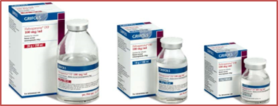
Flebogamma® 10% DIF
Description | Flebogamma® 10% DIF
Presentation | 5g (100mL), 10g (200mL), 20g (400mL) vials
Concentration | 10% Pay careful attention that you have the correct product strength
Source plasma | USA and European remunerated and non-remunerated donors
Stabiliser | Sorbitol
Storage conditions | Store below 30°C for up to 2 years Protect from light. Do not freeze
Infusion rate | First 30 minutes: 0.01 mL/kg/minute Second 30 minutes: 0.02 mL/kg/minute If tolerated increase by a further 0.02 mL/kg/minute each 30 minutes to maximum 0.08 mL/kg/minute Maximum rate 0.08mL/kg/minute (4.8mL/kg/hour)
Note: B. Flebogamma 5% and 10% is contraindicated in babies and young children as hereditary fructose intolerance may not yet be diagnosed and may lead to a fatal reaction associated with the sorbitol stabiliser.
Image: https://www.grifols.com/en/product/-/product/spain/flebogamma_10_dif

Slide 20
Flebogamma® 10% DIF infusion rate guide
Infusion rate mL/kg/min | Infusion rate mL/kg/hr | Pump rate | 10 kg | 20 kg | 30 kg | 40 kg | 50 kg | 60 kg | 70 kg | 80 kg | 90 kg | 100 kg | 110 kg | 120 kg
0.01 | 0.6 | mL/hr | 6 | 12 | 18 | 24 | 30 | 36 | 42 | 48 | 54 | 60 | 66 | 72
0.02 | 1.2 | mL/hr | 12 | 24 | 36 | 48 | 60 | 72 | 84 | 96 | 108 | 120 | 132 | 144
0.03 | 1.8 | mL/hr | 18 | 36 | 54 | 72 | 90 | 108 | 126 | 144 | 162 | 180 | 198 | 216
0.04 | 2.4 | mL/hr | 24 | 48 | 72 | 96 | 120 | 144 | 168 | 192 | 216 | 240 | 264 | 288
0.05 | 3.0 | mL/hr | 30 | 60 | 90 | 120 | 150 | 180 | 210 | 240 | 270 | 300 | 330 | 360
0.06 | 3.6 | mL/hr | 36 | 72 | 108 | 144 | 180 | 216 | 252 | 288 | 324 | 360 | 396 | 432
0.07 | 4.2 | mL/hr | 42 | 84 | 126 | 168 | 210 | 252 | 294 | 336 | 378 | 420 | 462 | 504
0.08 | 4.8 | mL/hr | 48 | 96 | 144 | 192 | 240 | 288 | 336 | 384 | 432 | 480 | 528 | 576
Increase rate by 0.01 mL/kg/min (0.6 mL/kg/hr) 30 minutely to the maximum rate or as tolerated by the patient.
This table is based on the FLEBOGAMMA® 10% DIF product information, always refer to the product information and your local Clinical Practice Guidelines for more information.

Slide 21
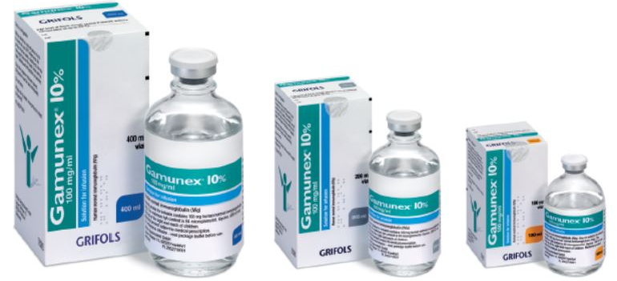
Gamunex® 10%
Description | Gamunex® 10%
Presentation | 5g (50mL), 10g (100mL), 20g (200mL) vials
Concentration | 10%
Source plasma | USA and European remunerated and non-remunerated donors
Stabiliser | Glycine
Storage Condition | Store at 2˚C - 8˚C for up to 36 months, may be stored at temperatures not exceeding 25˚C for up to 6 months anytime during the 36 month shelf life, after which the product must be used immediately or discarded. Do not freeze.
Infusion rate | First 30 minutes: 0.01 mL/kg/minute If well tolerated gradually increase rate to a maximum of 0.08 mL/kg/minute Maximum rate: 0.08 mL/kg/minute (4.8mL/kg/hour)
Picture published by Grifols Australia

Slide 22
Gamunex® 10% infusion rate guide
Infusion rate mL/kg/min | Infusion rate mL/kg/hr | Pump rate | 10 kg | 20 kg | 30 kg | 40 kg | 50 kg | 60 kg | 70 kg | 80 kg | 90 kg | 100 kg | 110 kg | 120 kg
0.01 | 0.6 | mL/hr | 6 | 12 | 18 | 24 | 30 | 36 | 42 | 48 | 54 | 60 | 66 | 72
0.02 | 1.2 | mL/hr | 12 | 24 | 36 | 48 | 60 | 72 | 84 | 96 | 108 | 120 | 132 | 144
0.03 | 1.8 | mL/hr | 18 | 36 | 54 | 72 | 90 | 108 | 126 | 144 | 162 | 180 | 198 | 216
0.04 | 2.4 | mL/hr | 24 | 48 | 72 | 96 | 120 | 144 | 168 | 192 | 216 | 240 | 264 | 288
0.05 | 3.0 | mL/hr | 30 | 60 | 90 | 120 | 150 | 180 | 210 | 240 | 270 | 300 | 330 | 360
0.06 | 3.6 | mL/hr | 36 | 72 | 108 | 144 | 180 | 216 | 252 | 288 | 324 | 360 | 396 | 432
0.07 | 4.2 | mL/hr | 42 | 84 | 126 | 168 | 210 | 252 | 294 | 336 | 378 | 420 | 462 | 504
0.08 | 4.8 | mL/hr | 48 | 96 | 144 | 192 | 240 | 288 | 336 | 384 | 432 | 480 | 528 | 576
Increase rate by 0.01 mL/kg/min (0.6 mL/kg/hr) 30 minutely to the maximum rate or as tolerated by the patient. This table is based on the Gammunex® 10% product information, always refer to the product information and your local Clinical Practice Guidelines for more information.

Slide 23
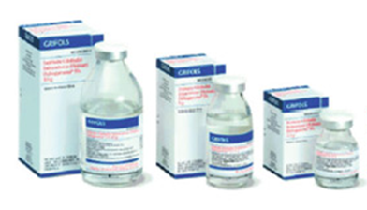
Octagam® 10%
Description | Octagam® 10%
Presentation | 5g in 50mL, 10g in 100mL, 20g in 200mL
Concentration | 10%
Source plasma | European and USA remunerated and non-remunerated donors
Stabiliser | Maltose
Storage conditions | Store at 2-8˚C for up to 2 years. Once removed from refrigeration, store below 25°C and use within 9 months. Do not freeze Protect from light
Infusion rate | Initial infusion rate: 0.6-1.2mL/kg/hour for 30 minutes If well tolerated, the rate of administration may gradually be increased to a maximum of 7.2 mL/kg/hour. Suggested rate of increase is 0.6mL/kg/hour each 30 minutes Maximum infusion rate is 7.2mL/kg/hour
National Blood Authority Australia - Annual Report 2010-11

Slide 24
Octagam® 10% infusion rate
Infusion rate mL/kg/hr | Pump rate | 10 kg | 20 kg | 30 kg | 40 kg | 50 kg | 60 kg | 70 kg | 80 kg | 90 kg | 100 kg | 110 kg | 120 kg
0.6 | mL/hr | 6 | 12 | 18 | 24 | 30 | 36 | 42 | 48 | 54 | 60 | 66 | 72
1.2 | mL/hr | 12 | 24 | 36 | 48 | 60 | 72 | 84 | 96 | 108 | 120 | 132 | 144
1.8 | mL/hr | 18 | 36 | 54 | 72 | 90 | 108 | 126 | 144 | 162 | 180 | 198 | 216
2.4 | mL/hr | 24 | 48 | 72 | 96 | 120 | 144 | 168 | 192 | 216 | 240 | 264 | 288
3.0 | mL/hr | 30 | 60 | 90 | 120 | 150 | 180 | 210 | 240 | 270 | 300 | 330 | 360
3.6 | mL/hr | 36 | 72 | 108 | 144 | 180 | 216 | 252 | 288 | 324 | 360 | 396 | 432
4.2 | mL/hr | 42 | 84 | 126 | 168 | 210 | 252 | 294 | 336 | 378 | 420 | 462 | 504
4.8 | mL/hr | 48 | 96 | 144 | 192 | 240 | 288 | 336 | 384 | 432 | 480 | 528 | 576
5.4 | mL/hr | 54 | 108 | 162 | 216 | 270 | 324 | 378 | 432 | 486 | 540 | 594 | 648
6.0 | mL/hr | 60 | 120 | 180 | 240 | 300 | 360 | 420 | 480 | 540 | 600 | 660 | 720
6.6 | mL/hr | 66 | 132 | 198 | 264 | 330 | 396 | 462 | 528 | 594 | 660 | 726 | 792
7.2 | mL/hr | 72 | 144 | 216 | 288 | 360 | 432 | 504 | 576 | 648 | 720 | 792 | 864
Increase rate by 0.6 mL/kg/hr 30 minutely to the maximum rate or as tolerated by the patient.
This table was developed using the Octagam® 10% product information, always refer to the product information and your local Clinical Practice Guideline for more information

Slide 25
Kiovig ® 10%
Description | Kiovig 10%
Presentation | 1g in 10 mL, 2.5g in 25 mL, 5g in 50 mL, 10g in 100 mL, 20g in 200 mL, 30g in 300mL
Concentration | 10%
Source plasma | European and USA remunerated and non-remunerated donors
Stabiliser | Glycine
Storage conditions | Store at 2°C to 8°C for up to 36 months from date of manufacture. Refrigerate. Do not freeze.
Infusion rate | Initial infusion rate: 0.5 mL/kg/hour If well tolerated gradually increased, by 0.5mL/kg/hour, every 30 minutes to a rate of 5.0 mL/kg/hour For subsequent infusions follow the same rate increase to the maximum rate tolerated in the initial treatment
Reference: Kiovig product information

Slide 26
Kiovig® 10% infusion rate
Infusion rate mL/kg/hr | Pump rate | 10 kg | 20 kg | 30 kg | 40 kg | 50 kg | 60 kg | 70 kg | 80 kg | 90 kg | 100 kg | 110 kg | 120 kg
0.5 | mL/hr | 5 | 10 | 15 | 20 | 25 | 30 | 35 | 40 | 45 | 50 | 55 | 60
1.0 | mL/hr | 10 | 20 | 30 | 40 | 50 | 60 | 70 | 80 | 90 | 100 | 110 | 120
1.5 | mL/hr | 15 | 30 | 45 | 60 | 75 | 90 | 105 | 120 | 135 | 150 | 165 | 180
2.0 | mL/hr | 20 | 40 | 60 | 80 | 100 | 120 | 140 | 160 | 180 | 200 | 220 | 240
2.5 | mL/hr | 25 | 50 | 75 | 100 | 125 | 150 | 175 | 200 | 225 | 250 | 275 | 300
3.0 | mL/hr | 30 | 60 | 90 | 120 | 150 | 180 | 210 | 240 | 270 | 300 | 330 | 360
3.5 | mL/hr | 35 | 70 | 105 | 140 | 175 | 210 | 245 | 280 | 315 | 350 | 385 | 420
4.0 | mL/hr | 40 | 80 | 120 | 160 | 200 | 240 | 280 | 320 | 360 | 400 | 440 | 480
4.5 | mL/hr | 45 | 90 | 135 | 180 | 225 | 270 | 315 | 360 | 405 | 450 | 495 | 540
5.0 | mL/hr | 50 | 100 | 150 | 200 | 250 | 300 | 350 | 400 | 450 | 500 | 550 | 600
Increase rate by 0.5 mL/kg/hr 30 minutely to the maximum rate or as tolerated by the patient.
This table was developed using the Kiovig® 10% product information, always refer to the product information and your local Clinical Practice Guideline for more information.

Slide 27
Pre-administration
Document baseline observations
Assess the patient for signs or symptoms that may be confused with a transfusion reaction
Hydration – ensure patient is well hydrated as this will help to reduce the risk of some reactions
Perform pre-administration patient and product identification checks (check local policy)
Check the integrity of the product
  All products should be clear or slightly opalescent liquids ranging from colourless to pale yellow
  Do not use solutions that are cloudy or have deposits
Notes:
Check:
if this is the first time the patient has received IVIg
if there has been an extended period of time between doses 6-8 weeks or more
the patient has had a change of product
If any of the above apply the rate of infusion may need to be slower than for patients who have been receiving IVIg regularly.

Slide 28
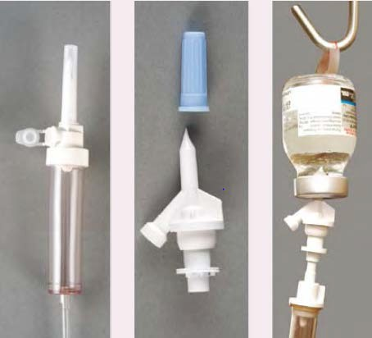
Administration
Allow IVIg to come to room temperature before use
Remove the plastic cover from the seal
Apply a suitable antiseptic (alcohol swab) to the exposed part of the rubber stopper and allow to dry (as per local policy)
NOTE: Administration from glass bottles requires a vented system. A vented system can be in the form of a vented spike adaptor, a side vent in an IV line or an airway needle.
The product does not contain any preservative or antimicrobial protection, each vial should be completed within 4 hours of piercing the rubber stopper.
Image: Flippin Blood 2nd edition, 2012

Slide 29

Infusion rates – paediatric/neonatal
Consideration should be given to running IVIg at slower rates for paediatric/neonatal patients.
Suggest discussing rate of infusion with a Consultant Paediatrician to determine the best rate for each child/infant/neonate.
Contact Royal Children’s Hospital for the latest paediatric and neonatal IVIg infusion guideline

Slide 30

Infusion rates
Each product has it’s own individual infusion protocol, make sure you are using the correct one
Infusion via pump is recommended for accuracy
Start with the smallest vials first, when the infusion rate is slowest as this helps to prevent waste if a reaction occurs

Slide 31

Precautions for all IVIg products
Consider using a slower maximum rate of infusion for:
  the elderly
  those at risk of thrombosis
  those with renal insufficiency
  paediatric and neonatal patients
    (check product information and previous slide)
Patients should be well hydrated and observed closely during infusion to reduce the risk of adverse events
Notes:
Rates may also need to be slowed if
if this is the first time the patient has received IVIg
if there has been an extended period of time between doses 6-8 weeks or more
the patient has had a change of product
the patient has had a previous infusion reaction

Slide 32

Patient observation
Document observations as per hospital policy
Patients with signs of reaction, or who have reacted previously, should be observed closely and more frequently and a slower infusion rate used
Recommended - out patients remain in the infusion centre for 20 minutes (minimum) following infusion

Slide 33
Adverse events
chills
headache
fever
arthralgia
nausea/vomiting
rash/allergy
low blood pressure
moderate low back pain
Some of the more common signs and symptoms for adverse reactions to IVIg

Slide 34
Adverse event response
Severe reactions
On advice of medical staff
Mild reactions
If the patient improves
Stop infusion
MET call if needed
Notify medical staff
Stop infusion – until clinical improvement
Notify medical staff
Treat symptoms
Cautiously restart infusion at a slower rate
Report and respond to reactions as per local policy
Report serious adverse reactions to the manufacturer

Slide 35
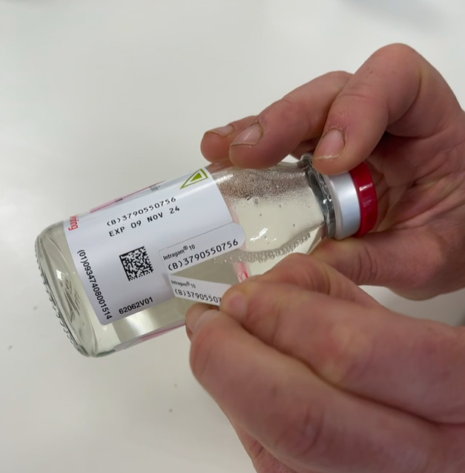
Traceability
To maintain a link between the product and the recipient always record the product name and batch number in the medical record
Product not used for the intended patient must be returned to the blood bank, pathology provider, pharmacy. It should never be kept in the clinical area for infusion to another patient.
Image courtesy Royal Melbourne Hospital 2023

Slide 36
Subcutaneous immunoglobulin (SCIg)
For patients with suitable conditions, consideration should be given to moving the patient to SCIg
Further information is available on the Blood Matters webpage
Why use SCIg?
SCIg can be administered in the home, either self administered or by a carer
SCIg provides stable immunoglobulin levels, leading to:
Fewer or less frequent infections
Reduced hospital admissions
Improved compliance with treatment as the patient has greater control of their own care
Do not need IV access
Systemic side effects are rare

Slide 37
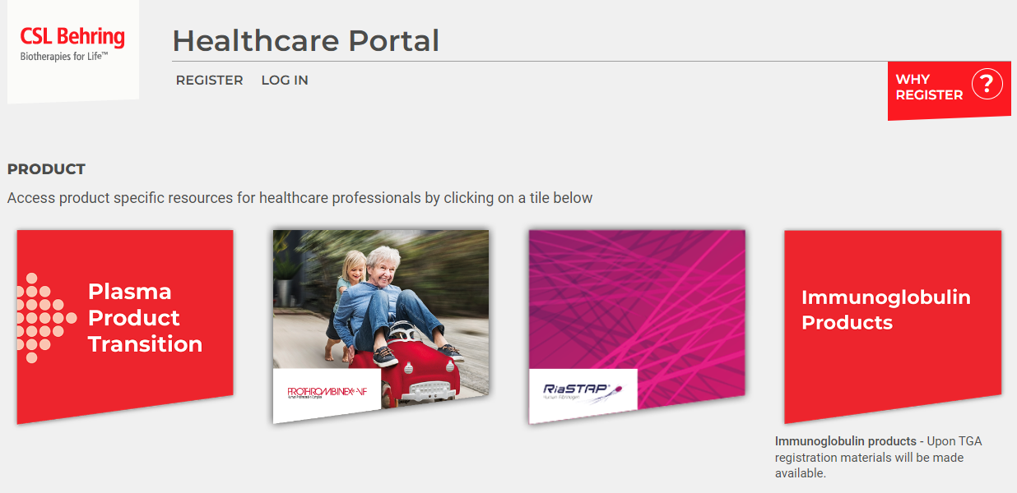
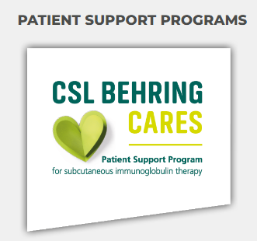
CSL Behring resources
Privigen WebApp - online Infusion Calculator
Can help with calculating individual patient infusion rates and schedules: https://www.privigen.com.au/privigen-webapp
https://hcp.cslbehring.com.au/

Slide 38

Useful links
Victorian Australian Red Cross Lifeblood Transfusion Nurses contact: vtatn@redcrossblood.org.au
Patient information: https://www.blood.gov.au/patient-factsheets-and- resources
CSL Behring: http://www.csl.com.au/products/product-finder.htm
Grifols: http://www.grifols.com
Octaphama: https://www.octapharma.com/australia/
Takeda Pharmaceuticals Australia Pty Ltd. https://www.takeda.com/en-au/what-we-do/our-products/
The National Blood Authority website also has information for patients changing products

Slide 39
References
Flebogamma® 5% DIF, Product Information. Grifols Australia Pty Ltd. 2012 https://www.grifols.com/en/products-services/-/product-search/australia
Flebogamma® 10% DIF, Product Information. Grifols Australia Pty Ltd. 2013 https://www.grifols.com/en/products-services/-/product-search/australia
Privigen ®, Product Information. CSL Behring (Australia) Pty Ltd. 2019 https://www.cslbehring.com.au/products/products-list
Privigen ® AU, Product Information and Compendium. CSL Behring (Australia) Pty Ltd. 2023, https://www.tga.gov.au/resources/artg/328605
Gamunex® 10% Product Information. Grifols Australia Pty Ltd. 2019 https://www.grifols.com/en/products-services/-/product-search/australia
Octagam® 10%, Octapharma Australia Pty Ltd. 2009, revised 2022 https://octapharma.com.au/wp-content/uploads/2022/10/octagam-10_PI_PDF.pdf
Kiovig®, Product information. Takeda Pharmaceuticals Australia Pty Ltd. https://www.tga.gov.au/resources/artg/198488

Slide 40

Acknowledgement/s
Australian governments fund the Australian Red Cross Lifeblood for the provision of blood, blood products and services to the Australian community.
Notes:
Australian governments fund the Australian Red Cross Lifeblood for the provision of blood, blood products and services to the Australian community.

Slide 41
Accessibility statement and publisher information
  To receive this presentation in another format phone, using the National Relay Service 13 36 77 if required, or email Blood Matters: bloodmatters@redcrossblood.org.au
  Authorised and published by the Victorian Government, 1 Treasury Place, Melbourne.
  © State of Victoria, Australia, Department of Health, March 2023.
  Available at Blood Matters program: https://www.health.vic.gov.au/patient-care/blood-matters-program

