Slide 1
Emergency use group O RBC
Education guidance for clinical staff
February 2023
OFFICIAL

Slide 2
Notes:
I acknowledge and pay respect to the past, present and future traditional custodians and elders of this land and the continuation of cultural, spiritual and educational practices of Aboriginal and Torres Strait Islander peoples.

Slide 3
Background
Group O RhD negative RBC are in constant demand, with shortages often experienced
Victorian 12-month average for O RhD neg RBC issues: 16.2%*
New O RhD negative Australian donors: 8.7%
* September 2022
Notes:
Group O RhD negative RBC are in constant demand, with shortages often experienced.
The Victorian 12-month average for O RhD negative RBC issues was 16.2% (to September 2022), whereas only 8.7% of new Australian donors are O RhD negative.
These O RhD negative donors are called in to donate frequently to make up the huge shortfall in supply versus demand, which is unsustainable.

Slide 4
O RhD negative RBC – supply versus demand
A large amount of O RhD neg RBC are held for emergency use where the patient’s blood group is unknown
Ongoing demand for O RhD negative RBC has become a challenge to support nationally
O RhD negative RBC need to be preserved for patients who have no alternative but to receive this group
Notes:
A large amount of O RhD negative RBCs is held for emergency use where the patient’s blood group is unknown:
Most of this is not used for emergency purposes
To ensure the blood is not time expired, it is often electively transfused to non-group O RhD negative patients. According to the “Blood Matters use of O RhD negative red blood cells according to guidelines audit report 2018”: 17% of O neg units were used to prevent time expiry
The ongoing demand for O RhD negative RBC has become a challenge to support nationally.
O RhD negative RBC need to be preserved for patients who have no alternative but to receive this group.

Slide 5
Appropriate and clinically indicated use of O RhD negative RBC
O RhD negative patients with anti-D antibodies
O RhD negative females of childbearing potential (age ≤ 50 years)
Emergency use for females of childbearing potential (age ≤ 50 years) of unknown blood group
O RhD negative children (males and females ≤18¹ years)
Emergency use for children of unknown blood group
¹ Or based on organisational definition of paediatrics
Notes:
Appropriate and clinically indicated use of O RhD negative RBC, which are consistent with the Guidelines for the use of group O RhD negative red cells. These Guidelines were developed and endorsed by The Australian Red Cross Blood Service (as known at the time) and the National Blood Transfusion Committee in 2008.
O RhD negative patients with anti-D antibodies
O RhD negative females of childbearing potential (age ≤ 50 years)
Emergency use for females of childbearing potential (age ≤ 50 years) of unknown blood group
O RhD negative children (males and females ≤18 years, or based on organisational definition of paediatrics)
Emergency use for children of unknown blood group

Slide 6
Safety of emergency use O RhD positive RBC
Group O RBC are ABO compatible with all ABO blood groups
O RBC will enable a patient to survive in a life threatening situation
No difference in risk of acute transfusion reaction between O RhD positive and O RhD negative RBC
>85% of the Australian population are RhD positive
RhD negative blood is not universally compatible with all patients
Notes:
Group O RhD positive RBCs are a safe and recommended therapy for most emergency transfusions where the patient’s blood group is unknown. They are ABO compatible with all ABO blood groups. O RBC will enable a patient to survive in a life threatening situation.
The use of O RhD positive RBC is standard practice in other Australian states, United Kingdom, Europe, United States of America and Canada.
There is no difference in risk of acute transfusion reaction between O RhD positive and O RhD negative RBC.
More than 85% of the Australian population are RhD positive, therefore O RhD positive RBCs are ABO and RhD compatible for these patients.
In Australia, the median trauma age is 48, with 72% of trauma patients being male (ATR 2019-20).
RhD negative blood is not universally compatible with all patients – there is risk of transfusion reactions and alloimmunisation occurring in some patient groups even with O RhD negative RBC.
The use of emergency blood is not without risks; it should only ever be used in life threatening situations to enable the patient to survive without serious ABO incompatibly consequences.

Slide 7
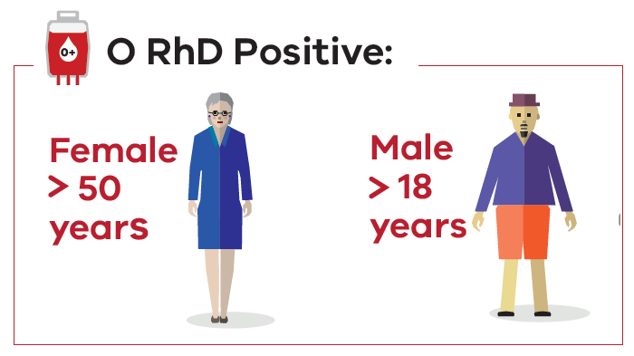
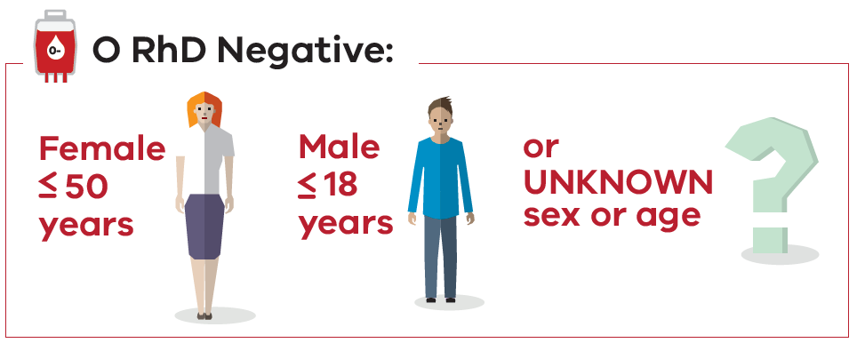
Emergency transfusion
O RhD positive RBC
(blue tag/sticker)
≤ 4 units O RhD negative RBC
(pink tag/sticker)
Notes:
In an emergency transfusion, where the patient’s blood group is unknown:
Group O RhD positive RBCs to be issued from the outset of transfusion support for females over 50 years and males over 18 years (or based on organisation definition of paediatrics).
Group O RhD negative RBCs to be issued for females 50 years and under and males 18 years and under.
For females ≤50 years and males ≤18 years, no more than 4 units of group O RhD negative RBCs will be issued in the absence of confirmed RhD negative status. The total number issued may be as few as two units depending on the availability of O RhD negative RBC.
Where the person’s age or gender cannot be determined, clinical judgement should prevail.
The number of O RhD negative RBC depends on how many are available at the health service – as few as 2 may be available.
O RhD positive RBC should then be given as necessary to sustain life.

Slide 8
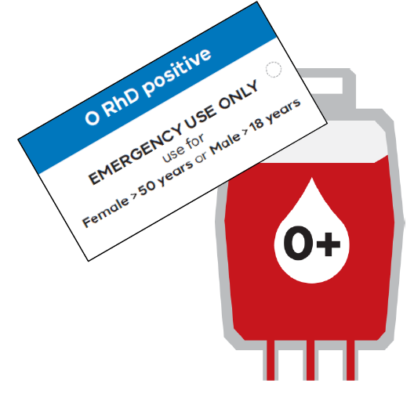
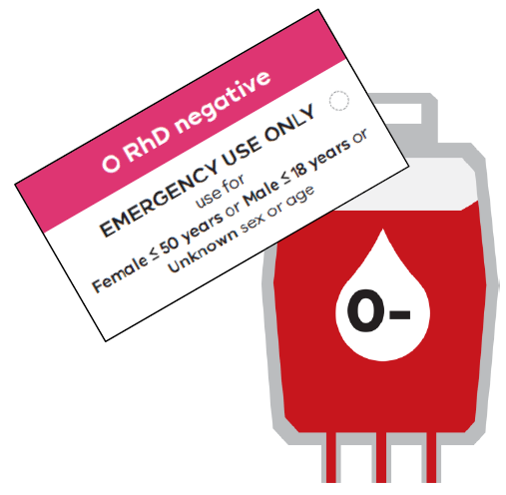
Identification of emergency use group O RBC
Notes:
Emergency use group O RBC must be clearly labelled and differentiated.
Where laboratories issue ‘packs’ for massive transfusion, consideration must be given to patient safety regarding the management of O RhD positive and O RhD negative RBC.
Where both emergency use O RhD positive and O RhD negative RBC are kept in satellite fridges, consideration must be given to how these are managed including clear labelling and indications for use.

Slide 9
Actions required by health services
Review emergency transfusion protocols and supporting procedures to implement recommendations
Audit use of emergency group O RBC to ensure compliance with policy
Investigate policy non-compliance, take actions to resolve compliance issues
Report near miss or adverse events to appropriate haemovigilance reporting system
Notes:
Actions required by health services
Victorian public and private health services, and laboratories, should review emergency transfusion protocols and other supporting procedures to implement the above recommendations.
Specific consideration should be given to how this will be applied to areas where emergency inventory is held remotely from the laboratory, and where patients of all ages are treated (e.g., emergency departments).
Implement audit of emergency use group O RBC to ensure compliance with policy. Policy non-compliance should be investigated, and actions taken to resolve compliance issues.
Report all near miss or adverse events to the appropriate haemovigilance reporting system

Slide 10
Key messages - emergency use group O RBC
Communicate with transfusion laboratory
Patient details (sex, age, name if available)
Clinical information
Urgency of transfusion
Obtain sample for group & screen/crossmatch ASAP
Prior to transfusion of uncrossmatched blood
Notes:
Ensure communication with transfusion laboratory, including:
Patient details (sex, age, name if available)
Clinical information
Urgency of transfusion
Obtain a sample for group and screen or crossmatch as soon as possible, and prior to transfusion of uncrossmatched blood (if possible).

Slide 11
Key messages - emergency use group O RBC
Switch to group specific/crossmatch compatible blood ASAP
Consider the management of RhD positive and RhD negative emergency use RBC
Massive transfusion/major haemorrhage ‘packs’
Satellite fridges
Notes:
Switch to group specific or crossmatch compatible blood as soon as possible.
Consider the management of RhD positive and RhD negative emergency use RBC, including massive transfusion/major haemorrage ‘packs’ and in satellite fridges where used.

Slide 12
Key messages - emergency use group O RBC
Emergency use group O RBC are only to be used in an emergency to save a patient’s life
Emergency use group O RBC are not without risk
Risk of serious morbidity/mortality resulting from bleeding should be prioritised over potential risk of alloantibodies
While crossmatched blood is preferable, DO NOT delay an urgent transfusion to wait for crossmatched units
Notes:
Emergency use group O RBC are only to be used in an emergency to save a patient’s life
Emergency use group O RBC are not without risk
Risk of serious morbidity/mortality resulting from bleeding should be prioritised over potential risk of alloantibodies
While crossmatched blood is preferable, DO NOT delay an urgent transfusion to wait for crossmatched units
Reducing the demand for O neg RBC will ensure ongoing availability for those patients for whom there is no alternative.

Slide 13
Further information and contacts
Further information and supporting documentation can be accessed on the Blood Matters webpage:
https://www.health.vic.gov.au/patient-care/blood-matters-program
Contact Blood Matters via email:
bloodmatters@redcrossblood.org.au
Notes:
Further information and supporting documentation can be accessed o nthe Blood Matters webpage, or alternatively contact via email.

Slide 14
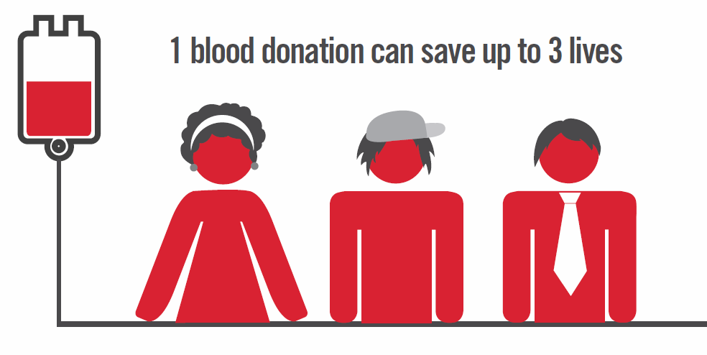
Acknowledgement/s
Australian governments fund the Australian Red Cross Lifeblood for the provision of blood, blood products and services to the Australian community.
Notes:
Australian governments fund the Australian Red Cross Lifeblood for the provision of blood, blood products and services to the Australian community.

Slide 15

Accessibility statement and publisher information
  To receive this presentation in another format phone 03 9694 0102, using the National Relay Service 13 36 77 if required, or email Blood Matters <bloodmatters@redcrossblood.org.au>.
  Authorised and published by the Victorian Government, 1 Treasury Place, Melbourne.
  © State of Victoria, Australia, Department of Health, February 2023.
  Available at Blood Matters <https://www.health.vic.gov.au/patient-care/blood-matters-program>

