Slide 1
Health Board Director Induction – Session 2
Risk management and Legal Responsibilities of board directors
Welcome – Jo Flynn, Chair – BMAC and your facilitator today
Director's legal duties and Enabling Legislation – Michael Gorton, Chair, Alfred Health
Risk management – Linda McCoy, Chair, Latrobe Regional Hospital
Integrity for board directors – Ella McPherson, Deputy Victorian Public Sector Commissioner
Question and answer session

Slide 2
Director’s legal responsibilities
Michael Gorton, Chairperson, Alfred Health

Slide 3
Individual Accountability
The role of a director is to fulfil their directorship responsibilities, and those responsibilities outlined in the Health Services Act, in a professional and ethical manner.
In practice, this means that directors must:
act in the interests of the health service at all times
act with integrity and in good faith
Hold themselves and each other to account
Attend meetings, having pre-read all board papers
Look beyond the obvious and not just accept the information presented
Be curious and well informed - inform themselves of issues/risks impacting the provision of health services.

Slide 4
Director’s conduct / Integrity issues
    Demonstrate leadership and stewardship
    Comply with establishing legislation
    Exercise due care, diligence and skill
    Act in the best interests of the public entity
    Use position and information appropriately
    Be fair and impartial
    Manage risks and be financially responsible
    Be honest and act with integrity
    Manage conflicts of interest and duty
    Champion a productive and ethical culture

Slide 5
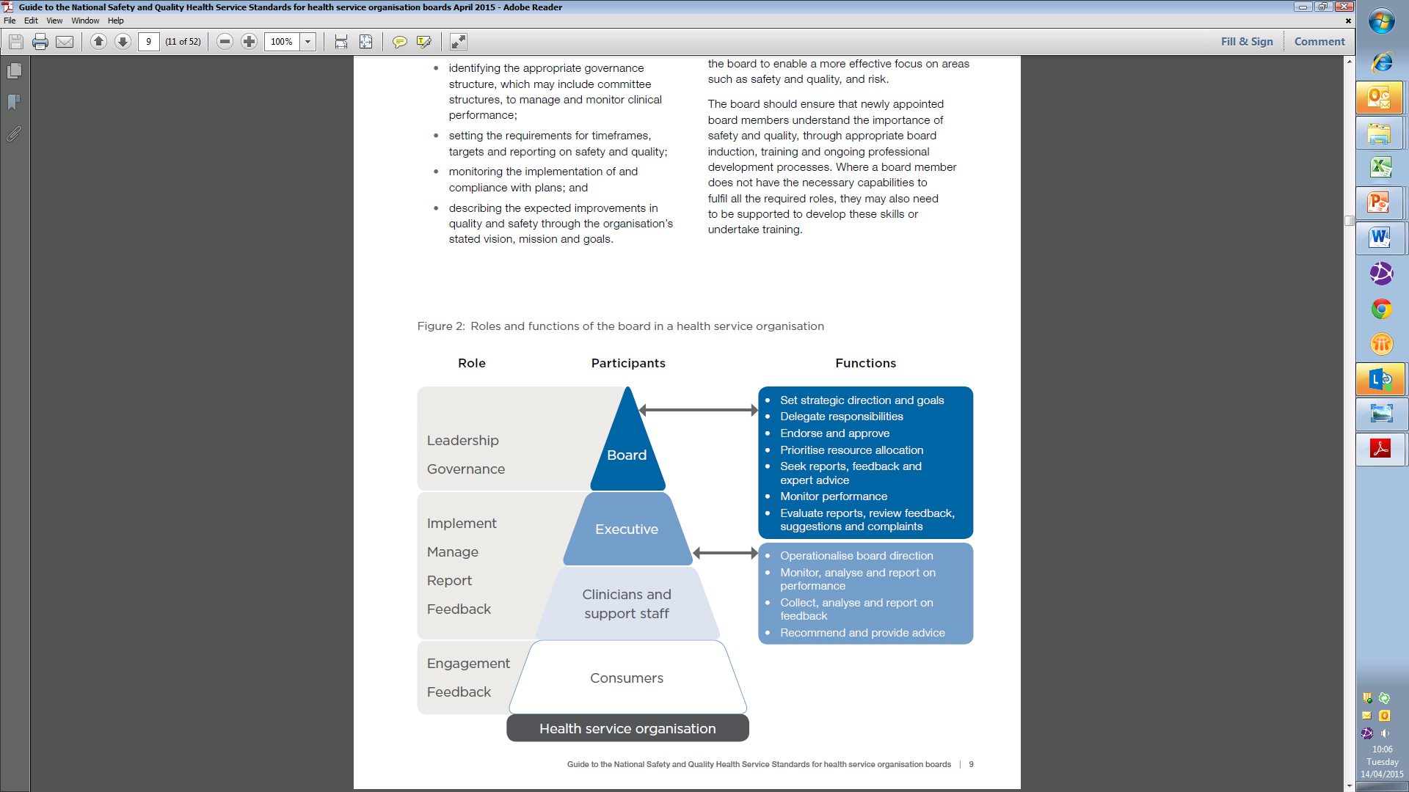
Governance roles and relationships

Slide 6
Governance and Management
Liability
Entity
Individuals
Vicarious liability
Criminal liability
Occupational Health and Safety Act 2004
Section 21 – An employer must so far as is reasonably practicable, provide and maintain for employees of the employer a working environment that is safe and without risks to health.
Section 23 – An employer must ensure, so far as is reasonably practicable, that persons other than employees of the employer are not exposed to risks to their health or safety arising from the conduct of the undertaking of the employer.

Slide 7
Role of the Board
Board | Management
Vision / Mission | Manage the business
Approve Strategic Plan | Implement Strategic Plan
Approve / monitor Business Plan | Implement Business Plan
Appoint / nominate CEO | Report to the Board on performance
Review / monitor risks | Manage risks
Delegate powers | Accept responsibility and report to Board (Reporting Framework)

Slide 8
What type of Board are you?
Internal / External
Short term / long term
Strategic / micromanaging

Slide 9
Board Processes
Work through the Chair (“first among equals”)
Collegiate, but testing
Manage disagreement (good people can disagree)
Bring “your skills” to the task (legal financial etc), but all are responsible. You are not the Board’s (lawyer / accountant / clinician / etc)

Slide 10
Legal responsibilities and enabling legislation

Slide 11
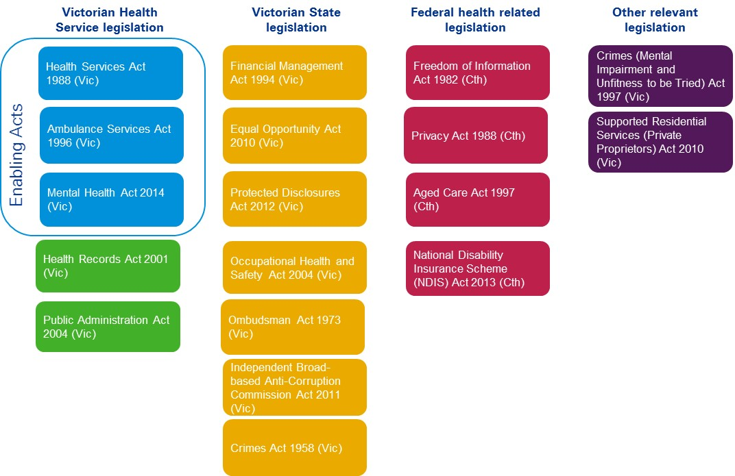
Relevant legislation
Public Administration Act 2004 (Vic)
Financial Management Act 1994 (Vic) and Standing Directions 2018
Audit Act 1994 (Vic)
Independent Broad-based Anti-corruption Commission Act 2011 (Vic)
Public Interest Disclosures Act 2012 (Vic)
Ombudsman Act 1973 (Vic)
Charter of Human Rights and Responsibilities Act 2006 (Vic)
Occupational Health and Safety Act 2004 (Vic)
Equal Opportunity Act 2010 (Vic)
Privacy and Data Protection Act 2014 (Vic)
Health Records Act 2001 (Vic)
Freedom of Information Act 1982 (Vic)
Public Records Act 1973 (Vic)
Victorian Data Sharing Act 2017 (Vic)

Slide 12
Enabling legislation
Enabling legislation | Health entities
Health Services Act 1998 (Vic) | Public hospitals Public health services Multi-purpose services
Ambulance Services Act 1986 (Vic) | Ambulance Victoria
Mental Health Act 2014 (Vic) | Victorian Institute of Forensic Mental Health (Forensicare)
All of these health entities are public entities under the Public Administration Act 2004 (Vic) (PAA).
Note: this presentation focuses only on the legal responsibilities of these health entities and their directors.

Slide 13
Director’s obligations – enabling legislation (all)
Key duties (all health entities)
Duty to consider specified matters The board must, in performing its functions and exercising its powers, have regard to the needs and views of the consumers and communities the entity serves, and the need to ensure public resources and the entity’s resources are used effectively and efficiently.
Duty to inform Minister and Secretary of issues of public concern or risk The board must ensure the Minister and the Secretary are informed in a timely manner of any issues of public concern or risk that may affect the entity and (except for Forensicare) are advised about significant Board decisions.
Duty to comply with Ministerial/Secretarial directions The board must comply with the directions of: the Minister (except for multi-purpose services); and the Secretary (except for public health services and Forensicare).

Slide 14
Director’s obligations – enabling legislation (some)
Key duties (some health entities) | Health entities
Duty to inquire and to give opportunity to be heard before dismissal/suspension The board must not dismiss or suspend any registered medical practitioner employed/engaged by the hospital unless the board inquiries into any matter alleged and gives the practitioner an opportunity to be heard. | Public hospitals
Duty of confidentiality It is an offence if a director (or a past director) gives any other person, directly or indirectly, acquired information that is identifying (in respect of a patient), except as necessary to carry out functions, to exercise powers, or to give any information as expressly authorised under any Act (subject to exceptions). | Public hospitals Multi-purpose services (amongst others)
Duty to disclose any pecuniary interest A director must disclose the nature of any pecuniary interest as soon as practicable after knowing the relevant facts. If the director has a conflict of interest, the director must abstain from voting and not be present on any relevant deliberations. | Public health services Ambulance Victoria
Duty not to exercise powers if there is a conflict of interest A person must not exercise powers or perform functions/duties in respect of another person if the person would have a conflict of interest. | Forensicare

Slide 15
Director’s obligations –
Public Administration Act 2004 (Vic)
Key duties
Duty to comply with Code of Conduct – s 61(3) | This Victorian Public Service Commissioner’s Code of Conduct for Directors of Victorian Public Entities is binding on directors of Victorian public entities.
Duty to act in good faith & with care and diligence – s 79(1) | Directors must act honestly; in good faith in the best interests of the public entity; with integrity, in a financially responsible manner; and with a reasonable degree of care, diligence and skill.
Duty not to give acquired information – s 79(2) | Directors (including past directors) must not give any person acquired information except to exercise functions or to give information as expressly authorised under any Act.
Duty not to misuse position or acquired information – s 79(3) | Directors must not improperly use their position or acquired information to gain an advantage for anyone or cause detriment to the public entity.

Slide 16
Director’s obligations –
Public Administration Act 2004 (Vic)
Key duties
Duty to notify board of candidature – s 79(4) | Directors must notify the board if they become a candidate for an election to Parliament or to a Council, and must not use any of the entity’s resources in connection with the candidature.
Duty of Chairperson to make available policies – s 80 | The chairperson must ensure that all policies adopted by, or relevant to, the entity are made available to all directors.
General duties of board – s 81 | The board must : inform the Minister and Secretary of known major risks to the entity and of the risk management systems in place, and provide the Minister with any information relating to the entity or its operations that the Minister requires (unless prohibited from doing so by any law); and ensure that adequate procedures (including in relation to directors’ code of conduct, conflicts of interests, and gifts), as well as controls to prevent fraudulent behaviour, are in place.

Slide 17
Other obligations/powers –
Public Administration Act 2004 (Vic)
No loans to directors – s 82 | The entity cannot make a loan or provide loan guarantee or security to a board director or their spouse or relative.
Subcommittees – s 83 | The entity can form or dissolve sub-committees, define their functions and membership and make delegations to directors who are members of sub-committees. Sub-committee membership is not restricted to directors of the board.
Subsidiaries – s 84 | An entity that intends to form a body corporate must, within a reasonable time before doing so, notify the Minister and the Treasurer of that intention. The entity must comply with any direction from the Minister not to form a body corporate or to impose restrictions or conditions.
Accountability – s 85(1) | The board is accountable to the Minister for the exercise of its functions.

Slide 18
Other obligations/powers –
Public Administration Act 2004 (Vic)
Injunctions – s 86 | The Minister has the power to obtain an injunction, including an interim injunction, restraining a director from engaging in conduct that contravenes the PAA or any other law.
Bringing of proceedings – s 87 | The responsible Minister has the power to bring proceedings or do so in the name of the public entity and to recover from the director as a debt due to the public entity, where a director has made a profit, or where the entity has suffered a loss or damage as a result of the contravention mentioned in section 86 (injunctions).
Insolvency/ conviction – s 89(8) | A director cannot be in office if the director is insolvent or convicted of an indictable offence.

Slide 19
Director protections
Immunity under enabling legislation
A director is not personally liable for anything done, or omitted to be done, in good faith in the exercise of a power or discharge of a duty (or in the reasonable belief that the act or omission was in such exercise).
Indemnities and insurance
Where directors who have acted honestly and properly are confronted with legal action, they may be able to benefit from an indemnity via insurance or from government under Victorian government policy.
Directors of public entities should be satisfied they either have appropriate insurance (usually termed Directors’ and Officers’ Insurance) from the Victorian Managed Insurance Authority or another appropriate insurance company or a government indemnity in limited circumstances.

Slide 20
Sign-off requirements and by-laws
Sign off requirements of boards
Directors must in the public body’s Annual Report attest to compliance with applicable requirements in the Financial Management Act 2004 (Vic), the Standing Directions 2018, and the Instructions supporting the Standing Directions 2018.
Directors must also disclose all ‘Material Compliance Deficiencies’ (defined in the Standing Directions 2018).
By-laws
The Board of each health entity (except Forensicare) has express power under the enabling legislation to make, amend or revoke by-laws, but must not make/amend by-laws without the Secretary’s approval.

Slide 21
Other key legal responsibilities
Legislation relating to information
Privacy and Data Protection Act 2014 (Vic)
Health Records Act 2001 (Vic)
Freedom of Information Act 1982 (Vic)
Public Records Act 1973 (Vic)
Victorian Data Sharing Act 2017 (Vic)

Slide 22
Other key legal responsibilities
Financial Management Act 1994 (Vic) and Standing Directions 2018
Audit Act 1994 (Vic)
Independent Broad-based Anti-corruption Commission Act 2011 (Vic)
Public Interest Disclosures Act 2012 (Vic)
Ombudsman Act 1973 (Vic)
Charter of Human Rights and Responsibilities Act 2006 (Vic)
Occupational Health and Safety Act 2004 (Vic)
Equal Opportunity Act 2010 (Vic)
Crimes Act 1958 (Vic)

Slide 23
Key regulatory bodies
Victorian Public Sector Commission | The VPSC is responsible for monitoring and reporting on compliance with the public sector values, codes of conduct, and public sector employment principles and standards by the relevant public officials (including directors of public entities) or public sector bodies.
Victorian Managed Insurance Authority | The VMIA provides risk management advice and insurance services to government departments and participating bodies (including any statutory authority that receives more than 50% of its funding from the Consolidated Fund).
Health Complaints Commissioner | The HCC receives, investigates, handles and reports any complaints made about health service providers.
Mental Health Complaints Commissioner | The MHCC accepts, assesses, manages and investigates complaints made about mental health service providers.

Slide 24
Key regulatory bodies
Independent Broad-based Anti-Corruption Commission | The IBAC is the agency responsible for identifying, exposing and investigating corrupt conduct in the public sector. Its functions include, amongst others, receiving and investigating complaints and notifications in relation to corrupt conduct in the public sector.
Victorian Ombudsman | The Ombudsman has the power to investigate complaints made about decisions, action or inaction of public bodies.
Office of the Victorian Information Commissioner | The OVIC has power to investigate the failure to perform or exercise a function or obligation under the Freedom of Information Act 1982 (Vic) by an agency or principal officer. It also has power to conduct audits of records of personal information to ascertain whether they are maintained according to the Information Privacy Principles and any applicable code of practice.
Australian Health Practitioner Regulation Agency | The AHPRA is the national organisation responsible for implementing the National Registration and Accreditation Scheme across Australia. It sets standards and policies that all registered health practitioners must meet.

Slide 25
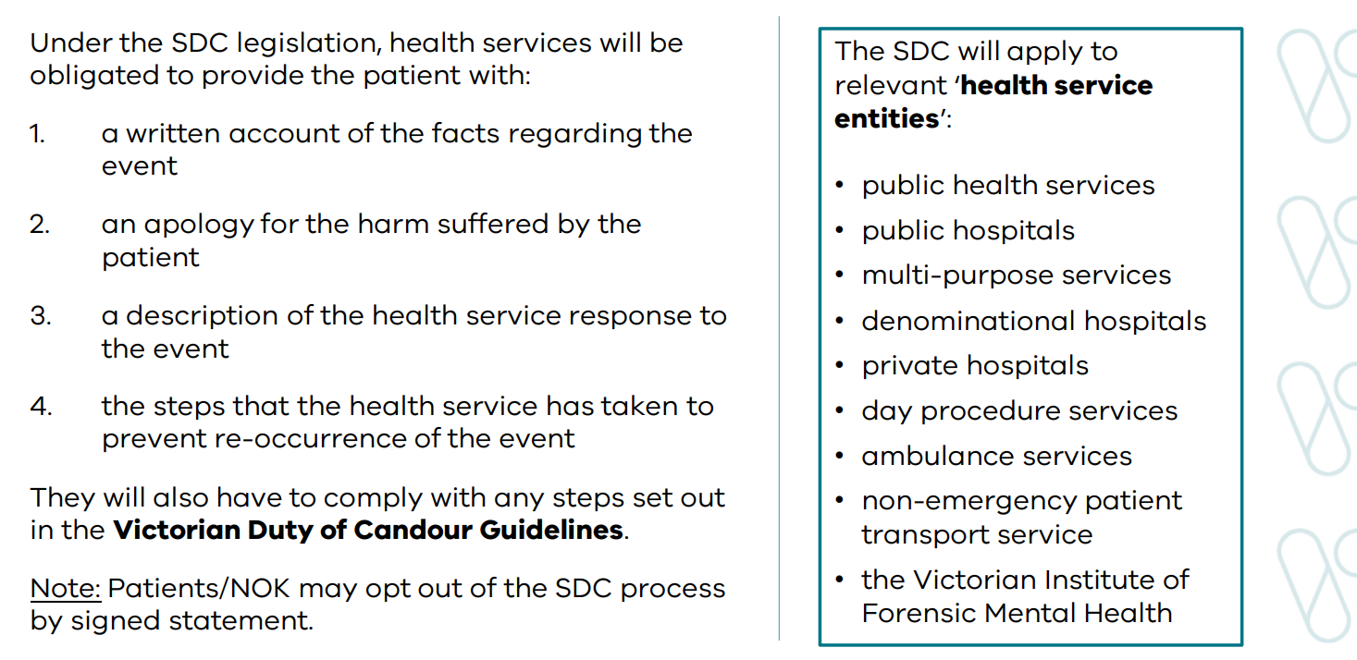
Statutory Duty of Candour (SDC)

Slide 26
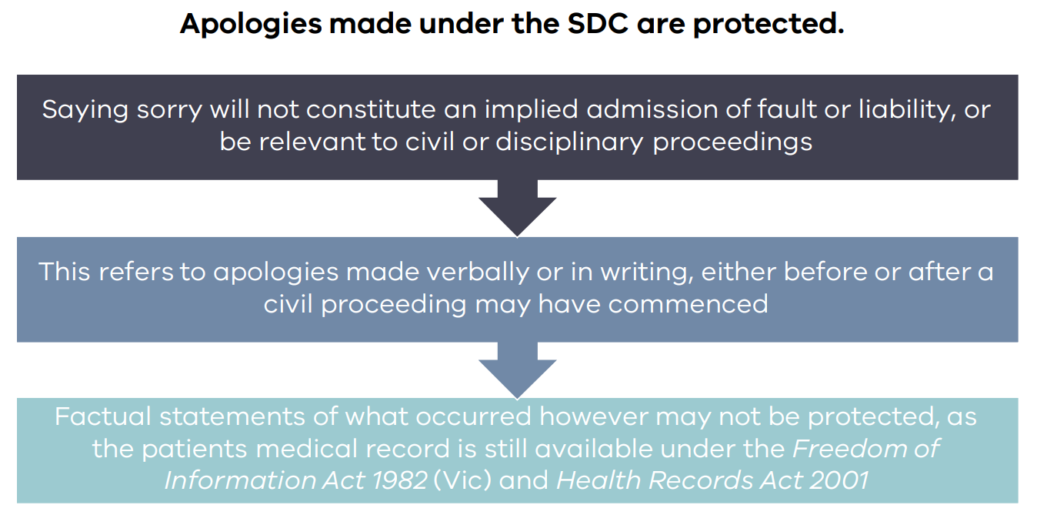
Statutory Duty of Candour (SDC)

Slide 27
Resources for board directors
The Directors’ Toolkit: The toolkit provides essential information on the public health sector environment and is available at: https://www2.health.vic.gov.au/hospitals-and-health-services/boards-and-governance/education-resources-for-boards/directors-toolkit
The Victorian Public Sector Commission (VPSC) provides multiple resources for members of public entity boards. These resources are available at: https://vpsc.vic.gov.au/governance/board-directors/
The VPSC’s code of Conduct for directors is available at: https://vpsc.vic.gov.au/resources/code-of-conduct-for-directors/
The Integrity Governance Framework: The integrity governance framework and better practice assessment and reporting tool are resources to assist Victorian public health services in assessing their integrity risks. Available at: https://www2.health.vic.gov.au/about/publications/policiesandguidelines/Integrity-governance-framework-and-assessment-tool-resources

Slide 28
Risk management
Linda McCoy, Chair, Latrobe Regional Hospital

Slide 29
Board responsibilities
Overseeing a risk management strategy and health service performance
Ensuring the Minister and the department are informed
Understanding the risk profile of the health service
Understanding, your risk appetite and thresholds, and ensuring these are well articulated to the CEO and documented

Slide 30
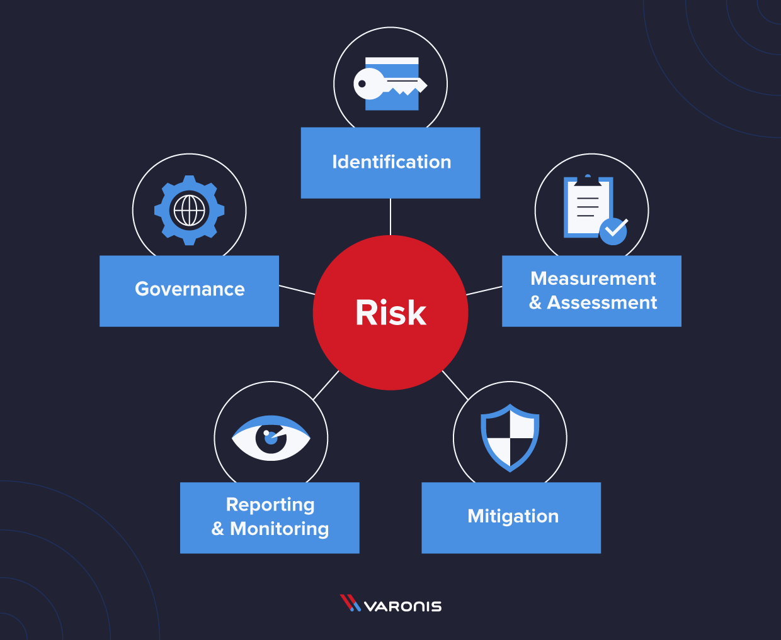
Principles & Framework

Slide 31
Risk and strategy
Understanding your risks should inform your strategy
Risk management is not simply compliance focused
Risk appetite statement
Risk governance – range of elements that together provide a framework for managing and monitoring risk

Slide 32
Key risk areas
Organisational
Financial
Legal/Compliance Risk
Physical Management
Clinical Risk
Integrity Risk

Slide 33
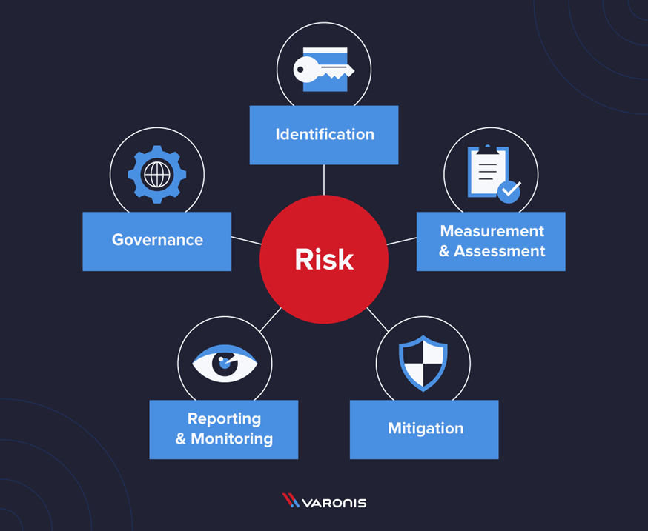
Framework

Slide 34
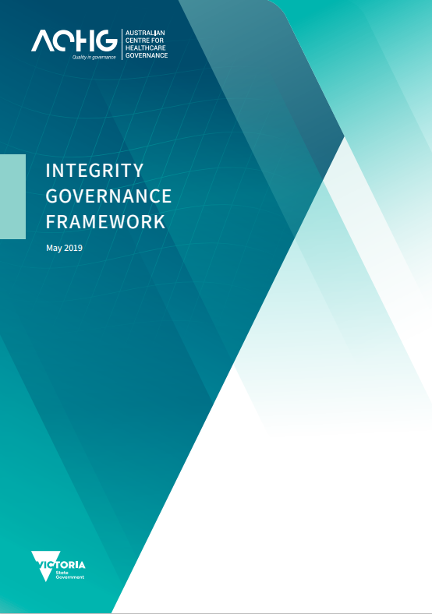
Integrity Governance Framework
The Integrity Governance Framework: The integrity governance framework and better practice assessment and reporting tool are resources to assist Victorian public health services in assessing their integrity risks.
Available at: https://www.health.vic.gov.au/publications/integrity-governance-framework-and-assessment-tool-resources

Slide 35
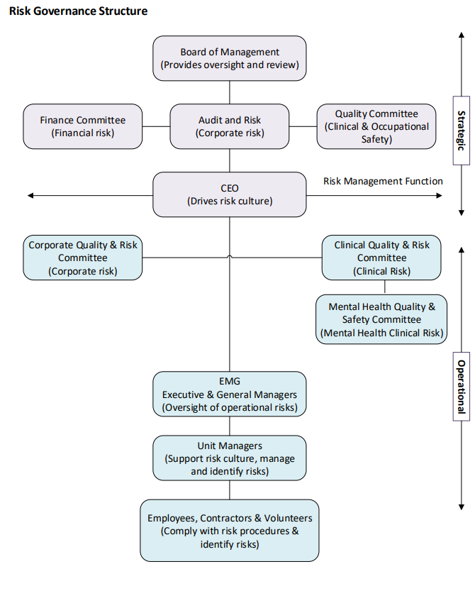
Board Process to Manage Risk

Slide 36
Board Process to Manage Risk
Approve, regularly review, and update the health service’s risk framework
receive regular updates about key risks and adopt early warning indicators and escalation protocols
monitor compliance with the Victorian public health sector policies
ensure there is a comprehensive risk register of current and emerging operational and strategic risks

Slide 37
Integrity for public board directors
Presented by Ella McPherson, Deputy Commissioner

Slide 38
Public vs private boards
Similarities ​
Key differences​
Some governance principles apply to both public and private boards, including duties to:
exercise a reasonable degree of care, diligence, and skill
act honestly and in good faith
not misuse position and information
disclose interests when conflict arises.
Private boards act in the best interests of shareholders or company members, while public boards have a duty to act in the best interests of the public.
Public boards must:
steer the board on behalf of the Minister
consult the relevant department and Minister on major issues
act consistently with their entity’s functions
comply with government policy and establishing legislation.

Slide 39
Responsibilities​ of health service boards and board directors
Board director​
The board​
Establish governance framework​
Set strategic direction​
Oversee financial performance​
Oversee risk management​
Oversee the organisation head​
Build a culture of integrity
Inform the Minister of major issues of public concern or risks that affect or may affect the heath service
Model values in the code of conduct​
Comply with conflict of interest and duty obligations​
Comply with gifts, benefits and hospitality obligations​
Health service boards
A health service is a statutory body established under the relevant Enabling Act.
The board must ensure the health service is compliant with the requirements of the Enabling Act.

Slide 40







Code of Conduct for Directors of Victorian Public Entities
7 public sector values
Caution!
Failure to behave in this way could be considered misconduct and in serious cases lead to suspension or removal from office. A director who improperly uses their position to gain an advantage for themselves or someone else, or causes detriment to a public entity will be liable for their actions under civil and criminal law.
Responsiveness
Integrity
Impartiality
Accountability
Respect
Leadership
Human Rights

Slide 41


Conflicts of interest and duty
Conflict of interest​
Conflict of duty
Private interest
Board director
Another duty
Declare
Review
Record
Manage
Declare
Review
Record
Manage
Direct interest
Your OWN personal, family, professional or business interests
Indirect interest
Individuals or groups connected
to you
Can be a public or private organisation

Slide 42
Conflicts of interest and duty (continued)
How to manage
The board should consider:
Record and monitor: details of the conﬂict of interest are recorded in the minutes. Monitoring occurs to check whether it remains the appropriate course of action.
Restrict: the director is allowed to take part in some discussions but not be part of any decision-making on the issue.
Remove: remove the director from all discussions and decision-making.
Recruit: appoint a third party to oversee a matter in part or full, ensuring they have no conflict of interest.
Relinquish or resign: recommend the director relinquish the private interest concerned. Alternatively, the director can be asked to resign.

Slide 43
Gifts, benefits and hospitality
All offers
Refuse and report
Minimum accountabilities
Refuse if:
It is money, items used like money, or items that can be converted to money.
It causes an actual, potential or perceived
conflict of interest.
It may affect your standing as a board director.
It may bring your organisation or the public sector into disrepute.
It’s a non-token offer without a real business benefit.
Other accountabilities
You must refuse:
All bribes or inducements.
You must report:
Bribery attempts and inducements to the board’s chair.

Slide 44
Gifts, benefits and hospitality (continued)
Token offers​
Non-token offers​
Not worth more than $50​
Token offers are of little value to the board director and the person making the offer.​
No need to declare or record in register.​
Accept if:​
They don’t create a conflict of interest or reputational damage, for example:​
pens and promotional items​
modest hospitality such as light refreshments.​
Worth more than $50​
Non-token offers may be of significant value and can include anything worth more than $50.​
You must declare and record in register.​
Accept if:​
It helps the organisation, public sector or the Victorian Government achieve its goals.

Slide 45
Public comment​
Best interest of the public entity​
Proper use of information​
Directors must act in good faith in the best interests of the board and be professional in all dealings with fellow directors.
They must not allow personal or professional interests or relationships to influence their judgment.
Directors must behave in a way that reflects well on their standing as a director and on the reputation of the public entity.​
Directors must use the information they gain in the course of their board duties only for its intended purpose.
They must not use the information, including sensitive information, to obtain an advantage for themselves or another person or to cause detriment to the public entity.​

Slide 46
Caretaker conventions​
Objectives​
Conventions​
Preserve the autonomy of an incoming government, in case the incumbent government is not returned.​
Ensure the State’s resources are used appropriately and not to the unfair advantage of the incumbent government.​
Protect the political neutrality of the Victorian public sector.​
As a director, ensure your public entity:​
avoids implementing major policy decisions that are likely to bind an incoming government​
avoids making significant appointments​
avoids entering major contracts or undertakings​
appropriately manages intergovernmental negotiations and visits​
maintains the apolitical nature of the Victorian public sector.​

Slide 47
Resources​
Guidance​
Find it online​
The Victorian Public Sector Commission has published new resources for public entity boards on boards.vic.gov.au. ​
The resources provide practical advice to help strengthen governance processes, focusing on the following areas: ​
  integrity ​
  governance ​
  financial management ​
  compliance and risk ​
  recruiting and overseeing the CEO.
Code of Conduct for Directors of Victorian Public Entities ​
Integrity guidance for board directors​​​
Board operations (including checklists and templates)​
​​Board management​
Managing CEOs​
Board events​
Diversity on Victorian Government Board Guidelines​
Why good governance matters: best practice for public entity boards
Guidelines on the Caretaker Conventions
Manager’s guide for working with employees involved in election activities

Slide 48
End of presentation

