Slide 1
Introduction
How to use this template
This PowerPoint presents the purpose, objectives and approach to your hospital travel plan. It includes a summary of your framework assessment, background analysis and staff survey results, which together inform the type of travel plan you are delivering (passive, active, comprehensive) and the priority actions you will deliver.
This strategic document is supported by a detailed action plan that you will create using the Travel Plan Actions Template (excel document in toolkit).
Instructions and more advice has been included in the notes section of slides.
[All text in red and square brackets explains what to include in each section. Red text needs to be replaced with the information described, or deleted where relevant.]
The rest of the text provides examples of what you may include. If it applies to your site you may want to leave it, otherwise adapt the text to make it relevant to your plan.
Insert your health service logo on the top right of each slide. Select the View tab from the ribbon bar and select ‘Slide Master’. Select the first slide. Select the image in the top-right corner (placeholder for logo). Open the context menu (right-click) and select ‘Change from file…’ Select your logo and close Slide Master view.
Remember to edit the alt text to ensure the presentation is accessible if you need to distribute the slide pack.

Slide 2
Accessibility
To receive this document in another format, phone insert phone number, using the National Relay Service 13 36 77 if required, or email insert contact or business name, then make the word ‘email’ and the contact or business name into a hyperlink of the email address <insert the email address here but do not make it a hyperlink, and do not remove the angled brackets>.
Authorised and published by the Victorian Government, 1 Treasury Place, Melbourne.
© State of Victoria, Australia, Department of Health, month year.
Available at insert web site or web page name and make this the hyperlink <insert full web address (URL) here but do not make it a hyperlink, and do not remove the angled brackets>

Slide 3
[Service name] hospital travel plan
[Date]

Slide 4
[Hospital Name] Travel Plan
[Health Service name’s] [hospital name] travel plan aims to make it easier for more staff to walk, ride a bike, carpool and use public transport to get to work more often.
[General introduction on hospital location and staff size]
We recognise that our staff car travel to work contributes to our carbon footprint and has the potential to impact on the amenity of our local community.
We also recognise that it is fair to raise the profile of, and remove barriers to non-car travel options so that people are not constrained to travel by car.
We understand that physical activity built into a daily commute – whether that’s a walk from an off-site car park or a ride to work – can benefit the mental and physical health of staff members who have limited activity during their workday.
This travel plan focuses on what [Health Service] itself can do to increase our staff’s non-car travel to work at [hospital name].
It also recognises our role, as a major destination in [region], to advocate to local council and state transport agencies to improve public transport services and infrastructure, such as road crossings and footpaths, to give our staff better options to walk, ride a bike or catch public transport to work.
Notes:
How to use this template
This PowerPoint presents the purpose, objectives and approach to your hospital travel plan. It includes a summary of your framework assessment, background analysis and staff survey results, which together inform the type of travel plan you are delivering (Passive, Active, Comprehensive) and the priority actions you will deliver.
This strategic document is supported by a detailed action plan that you will create using the Travel Plan Actions Template (excel document in toolkit)
[All text in red and square brackets explains what to include in each section. Red text needs to be replaced with the information described, or deleted where relevant.]
Blue text provides examples of what you may include. If it applies to your site you may want to leave it, otherwise adapt the blue text to make it relevant to your plan. When final, change to black text.
Once you have created a draft travel plan, delete these instructions and replace them with a photo of your site
Insert your health service logo on the bottom right of each slide.

Slide 5
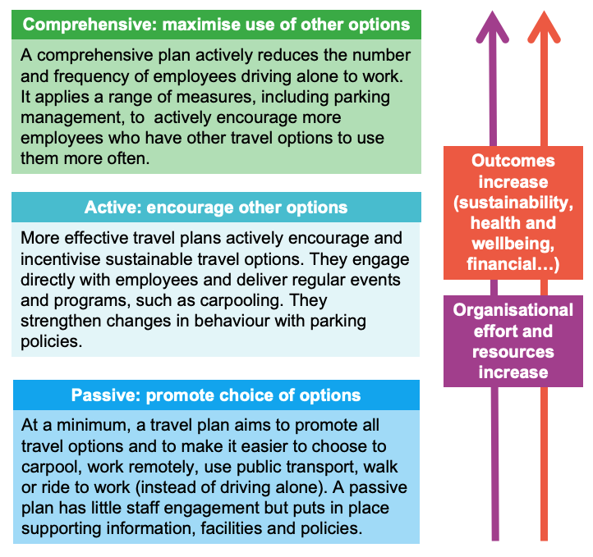
Our travel plan approach
Department of Health’s travel plan framework uses three levels of travel plan: passive, active and comprehensive.
A combination of factors influence the level of travel plan a workplace may aim to implement. One or more of these factors may support or hinder a plan’s development and outcomes. These factors include:
  how pressing travel-related issues are for the workplace and staff (such as parking availability)
  the organisation’s capacity and resources to respond to these issues
  the opportunity for employees to change to non-car travel, which relates to the total number of employees at the workplace and the availability of public transport and walking and cycling access.
[Health service name] has completed the Department’s framework assessment and background analysis to identify the level of travel plan level we will deliver at this time.
Notes:
do not delete this slide, it explains your travel plan methodology

Slide 6
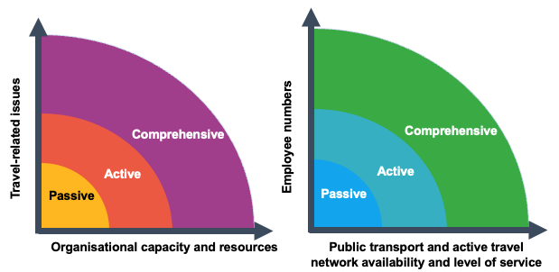
[Hospital Name] travel plan assessment
Our assessment identifies that we should deliver a [insert passive, active or comprehensive]-level travel plan for [hospital name].
The white dots on the graphs illustrate [hospital name]’s current position against the various factors that influence the level of travel plan that is likely to be effective at this time
Our assessment included:
  An audit of transport facilities and access on-site by all travel modes
  A desktop review and walk around the local area to assess ease of access by public transport, walking and bike riding
  Review of public transport availability
  A staff travel survey
  A staff focus group
  Internal stakeholder discussions and feedback to assess current processes and organisational success factors
As a major hospital with towards 5,000 employees, and many living close to work, we have the potential to deliver significant reductions in private car travel by implementing a comprehensive travel plan. However, issues relating to travel are relatively low and our public transport access is limited, which limits the relevance of a travel plan for our staff. Also, our organisation currently has limited capacity and resources to support an effective comprehensive plan, which would also require stronger parking management as a lever to change behaviours.
Notes:
This page summarises the outcomes of your background analysis and explains the level of travel plan you will focus on. Include an explanation, in the box after the graphs (content placeholder 3), of your assessment/insights and reason for the level travel plan. Move the white arrow on each graph to the relevant location to match your assessment. Also rotate the arrowhead to show the direction that you consider it is moving towards

Slide 7
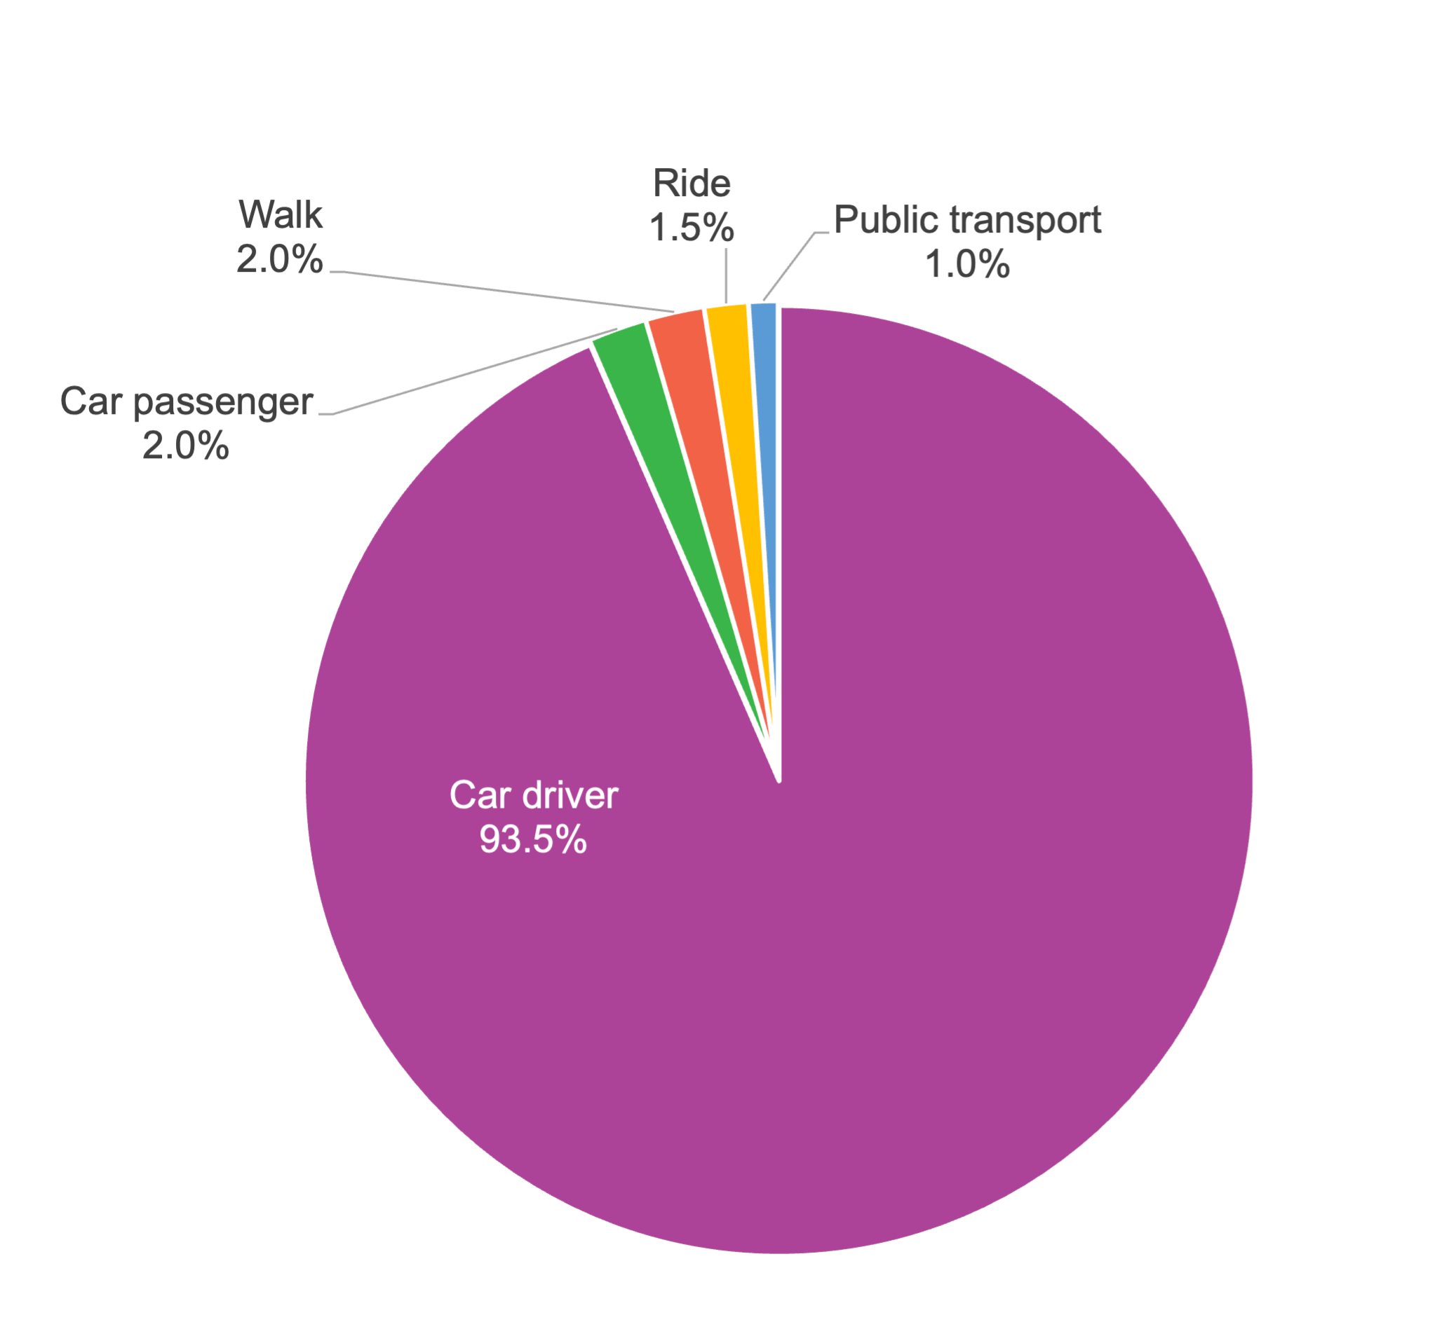
How our staff travel to work
We surveyed staff in [insert month and year] about their travel patterns and experience:
Over 93.5% of our staff regularly drive to work. Most (87%) have never used other travel options.
Over 3% of people regularly walk or ride to work; only 1% of staff use public transport.
Public transport is perceived to be unreliable, infrequent and time consuming
On-site car parking facilities receive very mixed ratings, and are a source of significant staff commentary/feedback
On-street parking may be impacting local amenity
While secure racks are available, cycling facilities are considered poor and pedestrian facilities also show significant room for improvement, particularly for safety
46% of staff arrive between 7:30 and 8:30 am and 40% leave between 4:30 and 5:30 pm, which may support some carpooling
Notes:
Describe the main results and insights from your staff travel survey/feedback.
This page focuses on the travel options people regularly and sometimes use, arrival and departure times and feedback on travel options. The slide shows some examples.
How to change the graph:
Save a picture of the chart you want to add and note where you save it
Select the placeholder image and open the context menu (right-click)
Select ‘Change picture’ then ‘From file’
Find the chart picture you just saved and select
Edit alt text and include the data (such as ‘Car driver: 93.5%, Car passenger: 2%, Walk: 2%’ and so on)

Slide 8
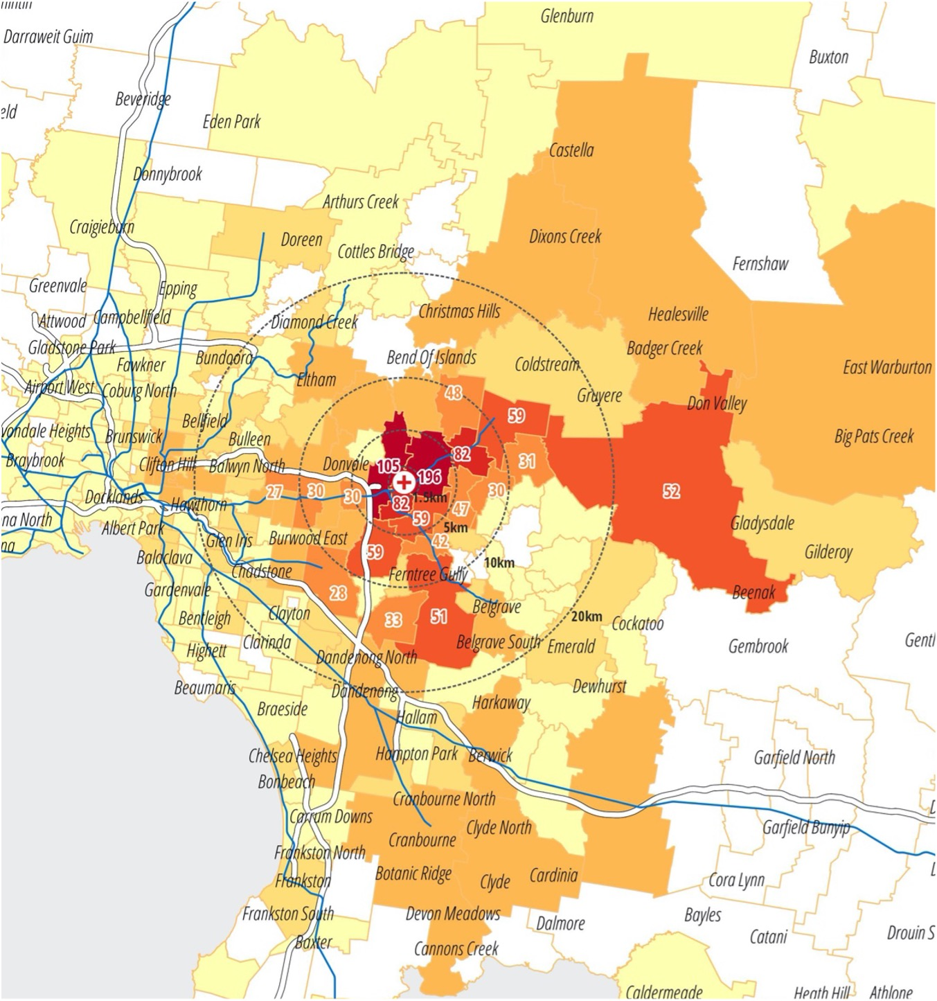
Travel distances and experience
Almost 20% of our staff live within 5km of work. Many people are driving very short distances to work.
65% of staff have a commute of less than 30 minutes
86% of people are satisfied or very satisfied with their commute
57% of staff say their commute is less stressful than their work day
Job flexibility and the uptake of remote work at [hospital name] is high, with almost a half able to work flexibility and a third of staff having done so
33% of people who identify that their job has some potential to be done off-site are not working remotely
Notes:
Include more results and insights from your staff travel survey, feedback and background analysis.
This slide focuses on the distances staff travel to work (estimated proportion of staff living close to work), their travel times, how satisfied they are with their current travel and remote work.
Depending on your travel survey (simple or more detailed) you may not have information on all these areas. The slide shows some examples.
How to change the image:
Select the placeholder image and open the context menu (right-click)
Select ‘Change picture’ then ‘From file’
Find the picture you want and select
Edit alt text and describe the information in the image

Slide 9

Opportunities identified from survey feedback and analysis
A high proportion of staff living close to work increases their options for walking or riding to work or parking off-site and walking a short distance to work
Continue to grow flexible work practices.
Make improvements to existing end of trip facilities and promote their availability
Improve safety and access for people walking on campus, including filling missing footpath links and adding pedestrian crossings
Test and apply changes to parking management to give priority to shift workers finishing outside usual business hours
Test and apply incentives for encouraging car sharing and potential to establish a car sharing program to reduce drive alone travel
Challenges
Short drive times, high levels of satisfaction with current travel options and low stress commutes are likely to limit the effectiveness of general promotional campaigns non-car travel options. More targeted actions for specific travel groups are needed.
Notes:
Describe the main opportunities that you have identified for increasing non-car travel to work and the main action areas that you will focus on, based on your background analysis and survey results.
This slide shows some examples.
Insert a photo from the site audit that shows something you want to change or improve as part of this plan, eg a missing footpath link on-site or to a local public transport stop
Are there any significant challenges you identify to your travel plan – based on your analysis or staff feedback or other organisational factors? If so, make a summary statement under the Challenges heading
How to change the image:
Select the placeholder image and open the context menu (right-click)
Select ‘Change picture’ then ‘From file’
Find the picture you want and select
Edit alt text and describe the information in the image

Slide 10
Our objectives, targets and actions
Targets
Increase the percentage of employees using active travel to work one or more day a week
Increase availability of parking for priority groups, including shift workers finishing out of business hours
Increase participation in active travel events and promotions
Program actions are embedded in other programs/work areas
Objectives
Make it easier to use other travel options by removing barriers
Fairly manage our limited parking resources by prioritising access to car parking based on need
Support the mental and physical health and wellbeing of our staff
Contribute to reducing our carbon footprint by reducing the proportion of private car travel to work by our staff
Deliver a program that is scalable and efficient and provides users with safe options
Actions
This plan has a 3-year horizon. Our priority actions are described next. A full list of our plan’s actions are listed in the table accompanying this plan, which has three priority phases:
  Phase 1 – 6 months to 1 year
  Phase 2 – 1 to 2 years
  Phase 3 – 2 to 3 years
We aim to strengthen our organisational capacity to deliver on our objectives, through:
  Expanding our focus on parking management to ‘travel and access’ and coordinating actions across existing roles within [Health Service].
  Increasing allocated resources to travel plan actions
Notes:
Change these example targets to match the ones you have selected or adapted from the Travel plan actions template.

Slide 11

Our travel plan actions – main themes
A full list of our plan’s actions are listed in the table accompanying this plan
Action area | Priority actions for our travel plan
Analysis | …
Information | Prepare a travel information page for the website Create and distribute a transport access guide
Communication | …
Facilities | …
Programs & events | …
Policy | …
Support | …
Advocacy | …
Evaluation | …
Reporting | …
Notes:
Insert the actions that you have selected from your travel plan actions template, which are the most important and that you will do in the first phase of your plan

